Slide 1
Islamic Finance: opportunities for
leasing development in Uzbekistan
Mr. Zafar Mustafaev
JSC “Uzbek Leasing International A.O.” and Leasing Association of Uzbekistan

Slide 2
Agenda
A
Republic of Uzbekistan
B
Financial market of Uzbekistan
C
Leasing market in Uzbekistan
D
Islamic Finance
E
Uzbekistan: Potential Market for Islamic Finance

Slide 3
Republic of Uzbekistan

Slide 4
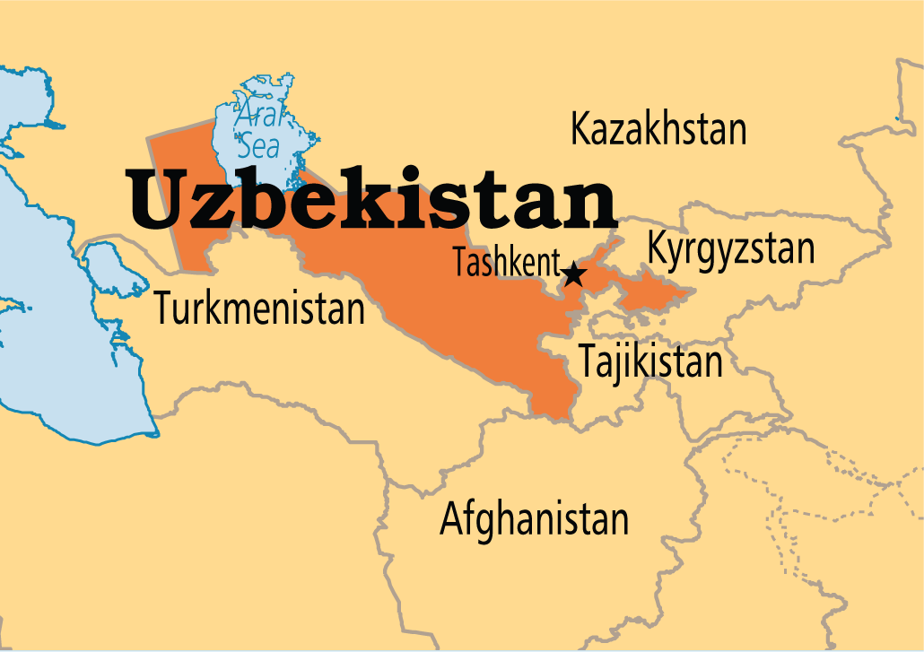
Republic of Uzbekistan 2018
GDP – USD 48,88 bln.
Capital investments – USD 12,86 bln.
Import volume – USD 19,5 bln.
Export volume – USD 14,2 bln.
Population - 32 mln.
Uzbekistan is among the top
ten countries in terms of
uranium reserves and mining.
The Republic has the potential to produce more than 10 mln.
tons of fruits and vegetables
per year.
More than 2800 resourse deposits and minerals have been identified in the republic, the total
mineral and raw material potential of the country is about USD 5.6 trln.
Uzbekistan occupies 11th place in terms of
copper reserves, 9th in terms of gold
production, 8th in uranium, 5th place in
cotton fiber.
The industry of the Republic is fully provided with natural gas,
oil and petroleum products, coal and electricity. 188 deposits of oil, gas and condensate, 3 coal deposits are explored here.
Uzbekistan has a great tourist potential of
both traditional tourism and pilgrimage, cities with a long history, such as Samarkand,
Bukhara, Khiva etc.

Slide 5
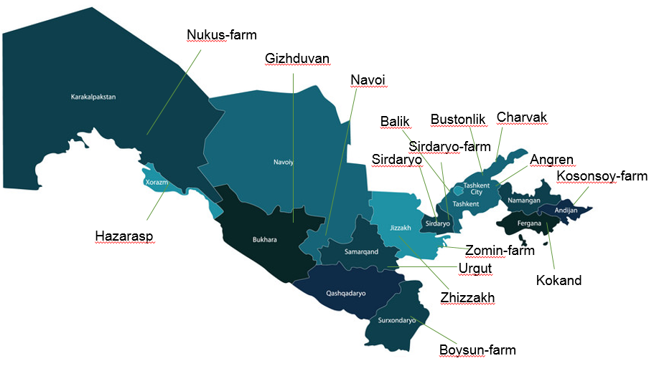
Free Economic Zones
Tax exemptions:
Land tax
Income tax
Property tax
Custom payments
Depending on the amount of
investments, the period of tax
benefits is from 3 to 10 years

Slide 6
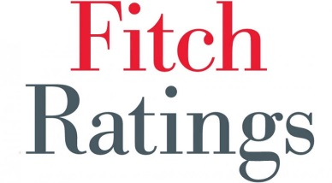
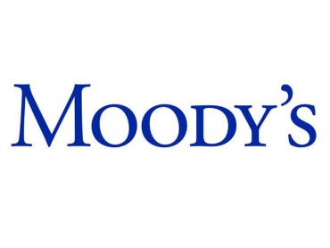
International rating
Doing Business
“BB-”, “Stable”
Uzbekistan | Doing Business 2018 | Doing Business 2019 | Difference from previous year
Global Rank | 74 | 76 | ↓2
Company Registration | 11 | 12 | ↓1
Property registration | 73 | 71 | ↑2
Loan obtaining | 55 | 60 | ↓5
Taxation | 78 | 64 | ↑14
“BB-”, “Stable”
“B1”

Slide 7
Financial Market of Uzbekistan

Slide 8
Banks of Uzbekistan
29 Banks in Uzbekistan
2019
№ | Name of bank | Share of assets
1 | National Bank of Uzbekistan | 27,9%
2 | Asaka Bank | 13,5%
3 | Uz PSB Bank | 13,2%
4 | Ipoteka Bank | 9,1%
5 | Agro Bank | 6,3%
6 | Xalq Bank | 4,8%
7 | Qishloq Qurilish Bank | 4,2%
8 | Hamkorbank | 2,8%
9 | Aloqa Bank | 2,5%
10 | Kapital Bank | 1,9%
86% of total market

Slide 9
Insurance companies
30 Insurance companies in Uzbekistan
2019
№ | Name of company | Share of insurance premiums
1 | Uzbekinvest | 16,4%
2 | Uzagrosugurta | 14,5%
3 | Gross Insurance | 12,6%
4 | Kafolat | 9,1%
5 | Euroasia insurance | 8,1%
6 | Alfa Invest | 6,0%
7 | Asia Inshurans | 4,4%
8 | Temiryo’l-Sugurta | 3,2%
9 | Mega Invest Insurance | 3,0%
10 | Kapital Sug’urta | 2,9%
80% of total market

Slide 10
Leasing Market of Uzbekistan

Slide 11
Leasing Association of Uzbekistan since 2005
The mission of Leasing Association of Uzbekistan is :
to create the conditions for the development of leasing services in the Republic of Uzbekistan to ensure the effective implementation of economic reforms in the Republic
to conduct training and seminars
to represent of the legitimate interest of member of the Association
to collect and analyze information about the activities of the Association, as well as the activities of Members of the Association;
Leasing Association has 29 members (27 leasing companies and 2 banks)

Slide 12
Volume of new lease deals
in bln.UZS

Slide 13
Leasing portfolio
in bln.UZS

Slide 14
Leasing market indicators
Investments in fixed assets through leasing
Year | Share of leasing in capital investment (%) | Share of leasing in GDP (%)
2013 | 2,8 | 0,7
2014 | 2,5 | 0,6
2015 | 2,3 | 0,5
2016 | 1,9 | 0,5
2017 | 2,6 | 0,6
2018 | 2,5 | 0,6

Slide 15
Leasing market structure by
leased assets in 1H - 2019
Agricultural machinery – 39,9%
Technological equipment – 37,4%
Real estate – 2,1%
Vehicles – 20,6%

Slide 16
Leasing market “players”
133 Lessors in Leasing market
1H-2019
№ | Name of lessor | Share of leasing portfolio
1 | O’zagrolizing | 33,9%
2 | O’zmeliomashlizing | 10,1%
3 | Uzbek Leasing International | 8,3%
4 | Asaka Bank | 6,0%
5 | O’zavtosanoat-Leasing | 5,9%
6 | Qurilishmashlizing | 5,8%
7 | Uz PSB Bank | 4,5%
8 | Ipoteka Bank | 2,0%
9 | Taiba Leasing | 1,9%
10 | Barqaror Lizing | 1,8%
80% of total market

Slide 17
Islamic Finance

Slide 18
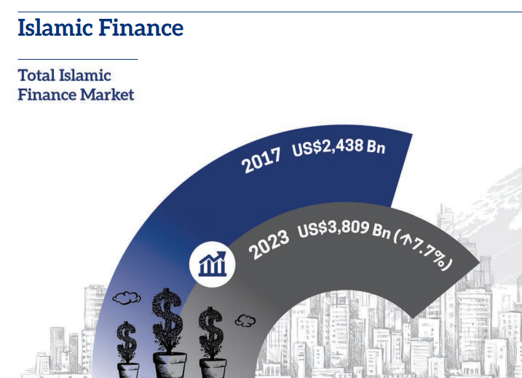
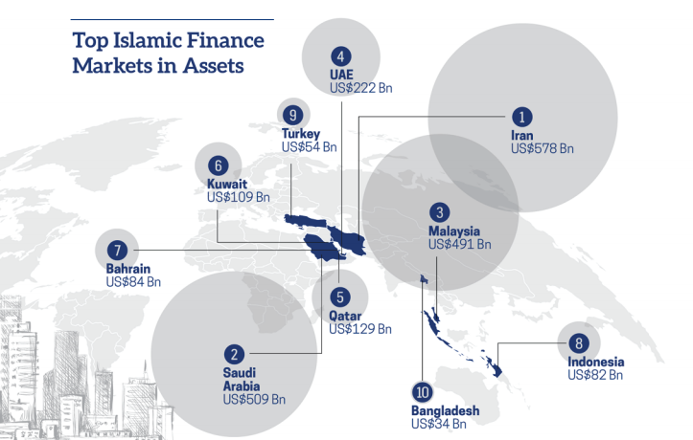
Global Islamic Finance
Amount of global Islamic financial assets
grew by USD 2,4 bln in 2017, it is
expected that by the end of 2023 it will
exceed USD 3,8 bln.
Islamic banking -71% of total assets;
Islamic bonds (Sukuk) -17%;
Islamic asset management funds - 4%;
Islamic insurance (Takaful) - 2%;
Remaining 6% of Islamic financial assets
are held by other Islamic financial institutions

Slide 19
Islamic Development Bank in Uzbekistan
Uzbekistan joined IsDB in 2003;
Total funding – USD 2 bln. in the areas:
Healthcare
Education
Irrigation
Energy
Water supply
Utilities
Road infrastructure
Small business support
Uzbekistan is also a member of ICD, ISFD and IRTI

Slide 20
Access to Islamic Finance in Uzbekistan
In May 2019, the government of Uzbekistan published a draft regulation on the creation of infrastructure for Islamic banking and finance in the country
The Central Bank was tasked with developing a legal and regulatory framework not only for Islamic banking, but also for Takaful and trading in securities, as well as for financing SME’s and microfinancing Halal
In addition, the introduction of Islamic finance in Uzbekistan will create healthy competition for traditional financing instruments and help to reduce interest rates

Slide 21
Leasing companies of Uzbekistan working with ICD
2008:
Murabaha facility from ICD – USD 1 mln
2014:
Murabaha facility from ICD – USD 5 mln
2017:
Murabaha facility from ICD – USD 7 mln
2010:
Equity capital of ICD – USD 5 mln
2014:
Murabaha facility from ICD – USD 5 mln
2016:
Murabaha facility from ICD – USD 5 mln

Slide 22
Why Ijarah is important in Islamic Finance
Enables customers to use fixed assets for fee who may be unable to buy them
Ijarah has also huge potential as a financing for retail.
It can be used as incentive to economic development.

Slide 23
Legal background of Ijarah in Uzbekistan
Chapter 34 of Civil Code is devoted to Ijarah(or Rent) and §6 of this chapter is devoted specifically to Financial Leasing;
According to Civil Code under the Ijarah agreement, the rentor undertakes to transfer the tenant for temporary possession and use or use of the property for a fee.
The Ijarah does not end with the ownership
The financial leasing under the legislation of the Republic of
Uzbekistan is conventional where the Lessee is obliged to
pay the principal plus interest on leasing
The leasing ends with automatic transfer of ownership

Slide 24
Practice of Ijarah in Uzbekistan
In 2018 Government rented out commercial properties and signed more than 24.3 thousand Ijarah (Rent) deals for the amount of UZS 63.1 bln; and as a result was created more than 5.7 thousand job places.

Slide 25
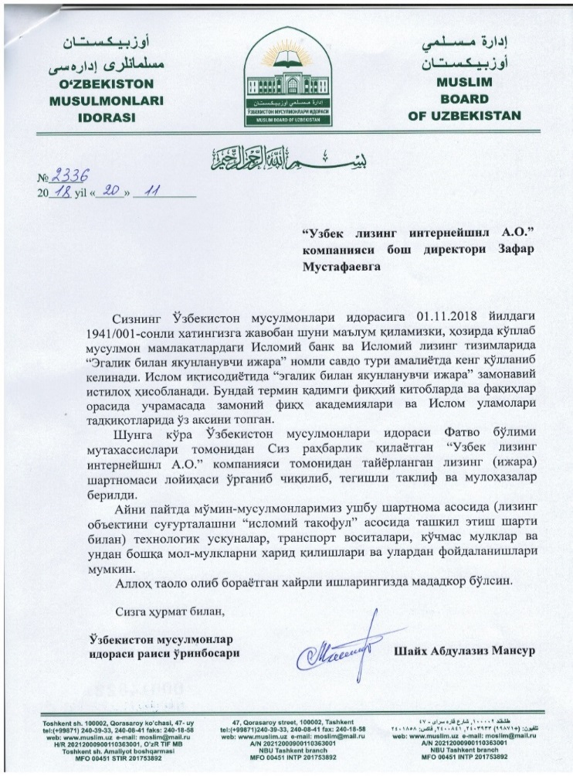
Existing Pipeline
Currently, there are more than 40 potential projects under consideration of Uzbek Leasing International on construction, medical, transport and other sectors for total amount more than USD 20 mln;
1/3 of the potential projects pipeline would prefer Islamic finance in the kind of Ijarah
instead of traditional leasing.
On 20th of November, 2018 Uzbek Leasing International received a permission (Fatwa) from Muslim board of Uzbekistan to finance Ijarah using Takaful insurance

Slide 26
since 1995

Slide 27
Shareholders
NBU
Maybank
(Malaysia)
41,56%
19,70%
38,74%
Uzbek-Oman Investment Company
Note: EBRD and IFC were shareholders from 1995 to 2012.
From 2012 UzOman purchased shares of EBRD and IFC

Slide 28
Date of establishment: 1995;
Representatives in the regions: 10;
Lease transactions: over 1000;
Total value of leasing deals: over USD 200 mln.

Slide 29
Advantages of Uzbek Leasing International
25 years of experience (since 1995)
International Standards (audited financial statements from Big 4 since 1996)
Corporate Governance, Management Information System
Risk Management Policy
Gender Action Plan
Environmental and Social Management System (ESMS)
“Small ticket” leasing by EBRD

Slide 30
Sources of Finance
Total USD 107.8 mln

Slide 31
Breakdown of lease portfolio

Slide 32
Uzbekistan: Potential Market for Islamic Finance
93,3% of population – muslims
High demand for the technological equipment and transportation from SME’s in Uzbekistan;
Average ROE is 20%;
85% of bank services are provided by state-owned commercial banks, which gives an opportunity to private commercial banks to compete and increase their services;
There is an increasing demand for Islamic finance in the country, 1/3 of the potential projects pipeline would prefer Islamic finance in the kind of Ijarah instead of traditional banking
According to preliminary estimates by IsDB experts, the introduction of Islamic finance in Uzbekistan will help to attract up to USD 10 bln in foreign investment in the country

Slide 33
Thanks for you attention!

