Slide 1
Global Development of Finance
And Ijarah Industry.
I
Muhammad Zubair Mughal
Chief Executive Officer
Allhuda centre of Islamic banking and economics

Slide 2
Islam and Ijarah
Notes:
Source: Institute of Policy Studies

Slide 3
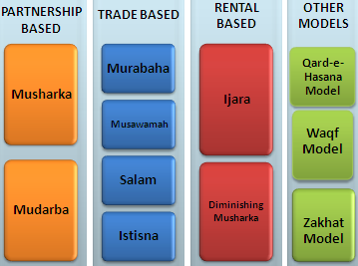
Sources & Utilization of Islamic Finance Products
Sources of Islamic Finance Products
Islamic Finance Product Mechanism
Quran
Sunnah
Ijma’a (jurist consensus)
Ijtihad & Qiyas (analogy)

Slide 4
Factors to be considered while doing Ijarah
Poverty Alleviation Element
and more….
Moral
Ethical
Social
A Misconception removed
Ijarah is a system not the Religion, it can be utilized & operated by both Muslims and
Non-Muslim Communities.
Takaful
IJARAH
Free from Gharar
Free from Interest
Financing
Shariah Compliants Funds
Ensure Shariah Compliance
Trainings & Quality HR
Shariah Vetted Products
Shariah Compliants Investments

Slide 5
Challenges faced by Ijarah Industry
Misconception
Non – Availability of Shariah Compliant Sources of Funds and Shariah Compliant Structure.
Need to develop a uniform regulatory and legal framework.
Accounting & I.T systems., Rating Agencies.
Lack of Quality HR
Standardization of the Products.
Reluctance in Research & Implementation
Development of Shairah Expertise.
Overall Economy Situation of Different Countries

Slide 6
Opportunities for Ijarah
Easy to Operate in any Jurisdiction compare than other Islamic Banking Products.
Emerging Trends/Awareness
Central Asia is Emerging Market
Expansion of Market where the Conventional Leasing limitations especially in Muslim Majority Countries
Social Welfare and Financial Inclusion.
Certain Tax Advantages compare than other financial Products
Solution for All
International Bodies Support – ICD, IsDB, AAOIFI, IFSB etc
Islamic Banking and Finance is emerging in South Asia, Central Asia & MENA region which will strengthened the Ijarah markets effectively.

Slide 7
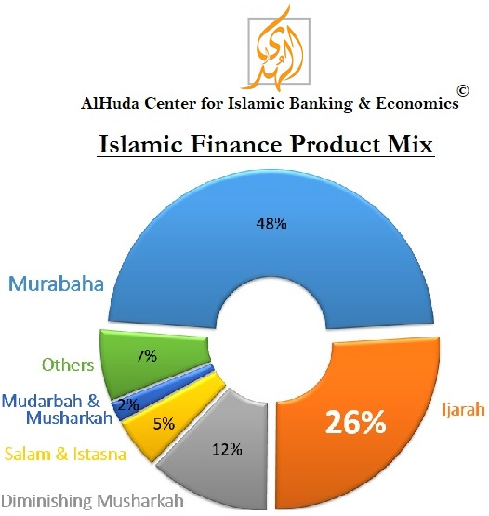

Slide 8
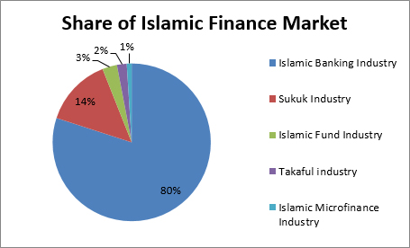
Global Size of Islamic Finance
orldwide is now estimated at:
Total Islamic Finance Industry Size: USD 2.7+ Trillion
2500 + Islamic Financial Institutions in 102 Countries
600 + Islamic Banking and Finance Education and Training Institutions.
By the end of 2020, the total volume of Islamic Finance Industry is expected to be USD 2.8 trillion.

Slide 9
Islamic Banking Industry
Share of Islamic Banking in Islamic Finance: 80%
Total Size USD 1.85 Trillion
In 100+ Countries.
Major Markets: Malaysia, KSA, UAE, Qatar, Pakistan, Iran, Indonesia etc.
Future Markets: Central Asia, East & West Africa, Eastern Europe, India, Russia etc

Slide 10
Takaful Industry
Share of Takaful industry in Islamic Finance: 2%
Total Size USD 30+ Billion
300+ Takaful Companies/Operators in 57 countries.
25 Re-Takaful companies
Major Markets: Malaysia, UAE, Qatar, Indonesia, Pakistan, KSA.
Future Markets: Turkey, Nigeria, Tunisia, Central Asia, Egypt.

Slide 12
Sukuk Industry
The number of Takaful operators worldwide is now estimated at:
Share of Sukuk industry in Islamic Finance: 14%
Total outstanding Sukuk Volume: USD 350 Billion
Total Number of out standing Sukuk: 1500+
Volume of Expected Sukuk in 2017: USD 78 Billion.
Major Markets: UAE, Qatar, Bahrain, Malaysia, Indonesia.
Future Markets: West Africa, Nigeria, Central Asia.

Slide 13
Islamic Microfinance
The number of Takaful operators worldwide is now estimated at:
Share of Islamic Microfinance in Islamic Finance: 1%
Total Size USD 1.5 Billion
500+ Islamic Microfinance Banks/Institutions
In 46 Countries.
Major Markets: Pakistan, Afghanistan, Yemen, Sudan, Nigeria, Iraq etc.
Future Markets: Jordan, Palestine, India, Albania, Turkey, Senegal, Togo, Tanzania etc.

Slide 14
Islamic Microfinance Institution Worldwide
Germany:2
- Muslim Society
Switzerland: 2
UAE: 4
- Dubai Islamic Bank
- Abu Dhabi Islamic Bank
- HSBC Amanah
UK: 5
- HSBC Amanah
- Muslim Aid
- Islamic Relief
Faith Matters
- The Halal Mutual Investment Company
Kuwait: 2
- Kuwait Finance House
United States: 3
Helping Hands
ISNA
Lariba
Bahrain: 2
Family Bank
Afghanistan 9:
- FINCA , WOCCU
- CHF
Ariana
Iran: 8
Pakistan: 21
India: 3
Bangladesh:9
Turkey: 2
- Faisal Finance Institution
- Ikhlas Finance House
Egypt: 3
- Alwatany Bank of Egypt
- Egyptian Saudi Finance
Malaysia: 11
2 - Pure Islamic Banks (Bank Islam, Bank Muamalat)
Rest - banks
Sudan: 13
Yemen: 05
Al- Amal
Al Kuraimi
South Africa
Awqaf SA
IMFI’s Worldwide: 500 *
Market Size: 1.5 billion USD
Indonesia: 133
BPRS , BMT.
Muaritius
AlBaraka MPCS

Slide 15
Islamic Finance Education & Training Providers
The number of Takaful operators worldwide is now estimated at:
Number of Education and Training Providers: 600+
150+ Universities have Islamic Banking and Finance Programs
Only Pakistan have 18 Universities
400+ Training Providers
In 50+ Countries.
Major Market: Malaysia, UK, Pakistan, Nigeria, Indonesia, Tunisia
Future Markets: Kenya, West Africa, Turkey.

Slide 16
Universities Offering Islamic Banking & Finance Programs Worldwide
Salford University, UK | Durham University, UK | Aston Business School, UK
La Trobe University, Australia | Effat University, Saudi Arabia | University College of Bahrain, Kingdom of Bahrain
Universiti Tun Abdul Razak, Malysia, | Emirates Institute for Banking & Financial Studies (EIBFS), UAE | The University of Bedfordshire, UK
Kulliyyah of Economics & Management Sciences, Malysia | University of Aberdeen UK | Institute of Islamic Banking and Finance, India
International Institute of Islamic Banking & Finance (IIIBF), Nigeria | The Markfield Institute of Higher Education, UK | Al Jamia Al Islamiya, India
INCEIF, The Global University of Islamic Finance, Malaysia | Qatar Faculty of Islamic Studies, Qatar | EUCLID, USA

Slide 17
Universities Offering Islamic Banking & Finance Programs Worldwide
London School of Business and Finance, UK | Bangor Business School at Bangor University UK | University of Reading UK
University Of Wales , Malaysia | The University of East London UK | University of Aberdeen, UK
Paris-Dauphine University, Paris | Al-Madinah Int’l University; Malaysia | University of Management and Technology Pakistan
Institute of Management Sciences, Pakistan | University of Central Punjab, Pakistan | International Islamic University, Pakistan
Ripah International University, Pakistan | Minhaj University Pakistan | COMSAT Institute of Information Technology, Pakistan

Slide 18
Institutes Providing Training in Islamic Banking & Finance Worldwide
Institute of Islamic Banking and Finance, India | AlHuda Centre of Islamic Banking & Eco | Islamic Banking And Finance Centre UK
Ethica Institute of Islamic Finance UAE | Academy for International Modern Studies (AIMS), UK | Islamic Research and Training Institute (IRTI) Saudi Arabia
Institute of Islamic Banking and Insurance, UK | Australian Centre for Islamic Finance, Australia | National Institute of Banking And Finance(NIBAF), Pakistan
The Institute of Bankers Pakistan | Centre for Islamic Economics, Pakistan | International Institute of Islamic Finance, INC. Malaysia
INCEIF, The Global University of Islamic Finance, Malaysia | Guidance Institute | BIBF, Kingdom of Bahrain
Notes:
International Institute
of Islamic
Finance, INC.

Slide 19
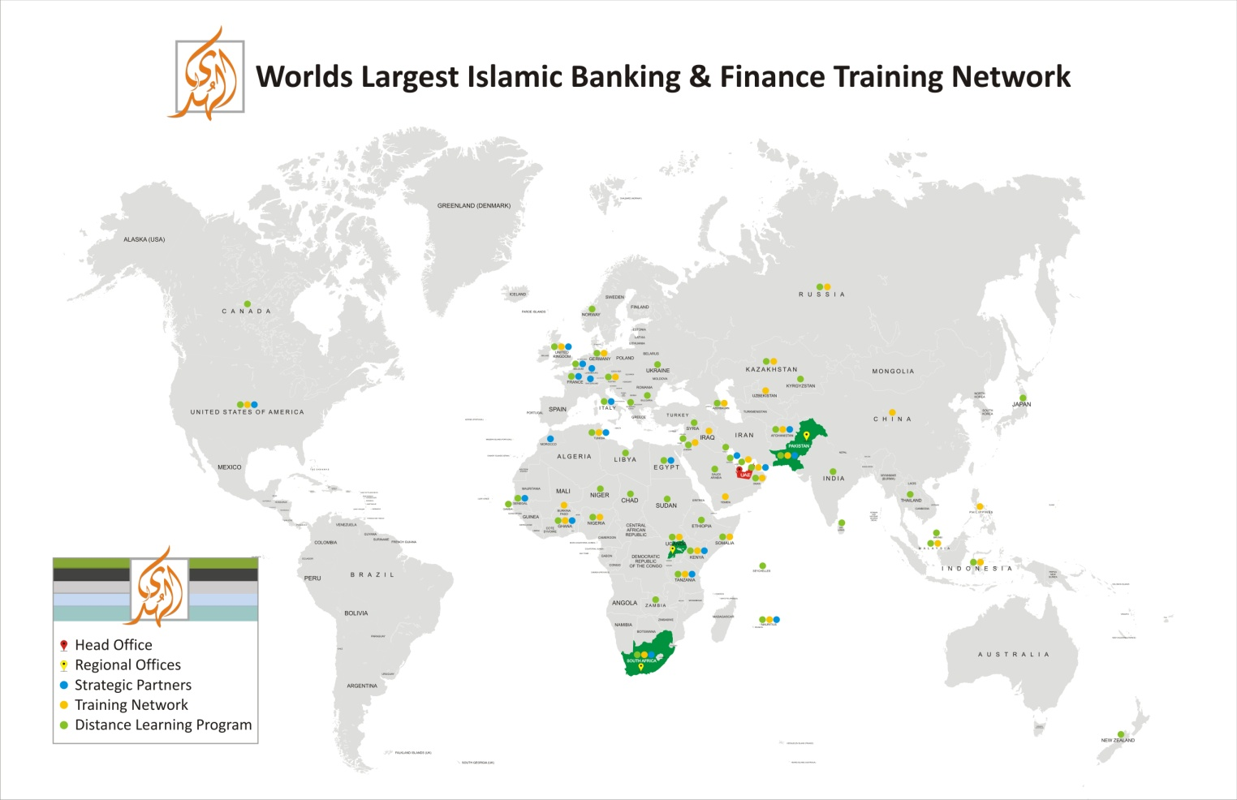

Slide 20
JazzakAllah Thank you for listening with patience
Muhammad Zubair Mughal
Chief Executive Officer
AlHuda Centre of Islamic Banking and Economics
Zubair.mughal@alhudacibe.com
www.alhudacibe.com

