Slide 1
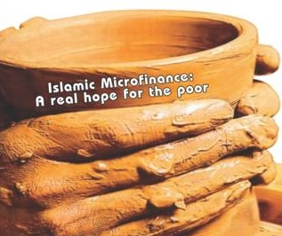
Muhammad Zubair Mughal
Chief Executive Officer
Alhuda centre of Islamic banking and economics
www.alhudacibe.com
Islamic Microfinance
An Effective Tool of Poverty Alleviation & Social Development
Specialized Training Workshop on Islamic Microfinance
19th – 20th Jan, 14 at Amman - Jordan

Slide 2
Contents
Source of Islamic Microfinance Products
Basic Principles of Shariah Based Microfinance
Elements of Islamic Microfinance (IMF)
Compatibility of IMF Products with Conventional Microfinance Models
Islamic Microfinance Institutions – Worldwide
Need Assessment of Islamic Microfinance
Opportunities & Challenges Faced by IMF Sector
Notes:
My presentation will cover following Area’s

Slide 3
Basic Principle of Shariah Based Microfinance
Prohibition of Interest.
Free from Gharar.
Care for the poor is a religious
obligation in Islam.
Asset Based Financing
Risk Sharing
Sanctity of contracts
Financing in Halal/Shariah Complaint Activities.
Prohibition of speculative behaviour ( Gharar )
Micro Takaful ( Islamic Micro Insurance)
“Assisting the poor is a pillar of Islam”
Notes:
This is an important principle of Islamic Microfinance, Actually, interest is forbidden in all the divine religion but Islam have strict verdict on it. Therefore Muslim hesitant to unutilized Conventional financial system and remains exclude from financial access.
It is Necessary that all contracts should be free from Gharar.
Infact, poverty alleviation is the religious obligation in Islam.e.g. Zakhat, Sadqa ( Donation ) , Tabbrumm, Fitrana , Ushre etc, which are dedicated for financial well being of Poor peoples.
Islam always encourages Asset based Financing, we have seen the recent international financial crises, and learned a lesson that financing without the backing of assets is always risky.
Risk Sharing is one of the fundamental principle of Islamic Microfinance.
Islamic Microfinance Emphasizes the Sanctity of Contracts.
Micro Takaful is a Shariah Compliant System of Risk Mitigation.

Slide 4
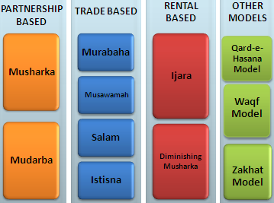
Overview of Islamic Microfinance Mechanism
Source of Islamic Microfinance
Islamic finance is the outcome of religion in banking
Sources of Islamic Microfinance
Islamic Microfinance Products Mechanism
Quran
Sunnah
Ijma’a (jurist consensus)
Ijtihad & Qiyas (analogy)
Notes:
Lets examine how Islamic Microfinance Products originated, Basically there are Four Main sources of Islamic Microfinance product, 1) Quran-e- Pak, the holy book of Muslims, we have derived many Islamic Microfinance product from Quran-e-Pak e.g Ijarah, Bai etc, the Second source of Islamic Microfinance is Sunnah, its mean the sayings & Practiced by the Holy Prophet Hazrat Muhammad Salalah wa all he walis, Many Islamic Microfinance Product have been derived from Sunnah such as Mudarabah, Wakala, Intisna etc , Ijma’a , the consensus among Jurists, some Microfinance Product derived from Ijma’a Like Late payments charity mechanism which is being utilized in Islamic Microfinance Sector, and the last source is Ijtihad & Qiyas ( Analogy ) , Takaful or Micro Takaful is example of Ijtihad.
As per concern about Islamic Microfinance Product, I have segregated them into 4 categories for broader understanding about their mechanism. In partnership Mode, MFI’s & their clients enter into Partnership agreement for a business venture on profit and Lose sharing Mechanism. we have two Product in Partnership based mode, Musharakah & Mudarabah. In Trade based Mode, MFI’s & their Clients enter into trading agreements, the products of Trade based Modes are Murabahah, Musawamah, Salam and Instisna. There are two products in Rental based mechanism, Ijarah is Shariah Compliant mode of leasing and Diminishing Musharakah. There are some other Modes in Islamic Microfinance available, like, Qard-e-Hasan, Waqf & Zakhat, Islamic Cooperatives etc. We will discuss about these products latter on

Slide 5
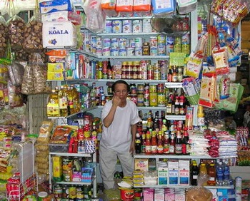
-
Products in Islamic Microfinance
Murabahah - Cost Plus Sale
Literally it means a sale on mutually agreed profit, also known as cost plus sales, it is one of the most widely used instruments for short-term financing where the MFI undertakes to supply specific goods or commodities at mutually agreed profit to the client.
Utilization:
Murabahah can be utilize for Purchase of raw materials, equipment, agri. Inputs, Consumer goods, Vehicle, Houses etc in Microfinance Sector.
Currently Practiced:
AlBaraka MPCS, Al Amal Bank – Yemen, Asasah,
Islamic Bank Bangladesh, FINCA , Muslim Aid,
Islamic Relief etc.
Notes:
Murabahah is widely used modes of Islamic Microfinance, if we have look at Islamic Microfinance Product profile, then we have come to know that only 80% Murabahah is being utilized in Islamic Microfinance industry.

Slide 6
Products in Islamic Microfinance
Musharaka - Partnership
Musharakah means a relationship established under a contract by the mutual consent of the parties for sharing of profits and losses in the joint business.
Utilization:
Musharka can be used for Microenterprise setup’s, Small productive projects, Working capital financing, etc.
Currently Practiced:
CWCD, Helping Hands, AlBarakah MPCS etc.
Notes:
Musharakah is Partnership mode of Financing.

Slide 7
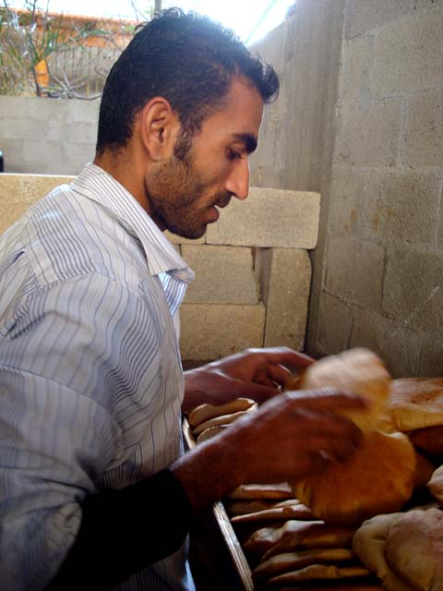
Products in Islamic Microfinance
Mudarabah - Partnership
A trustee-type finance contract under which one party (MFI) provides the capital for a project and the other party ( Client) provides the labor/Skill. Profit sharing is agreed between the two parties on mutual consent but the losses should be borne by the provider of funds .
Utilization :
Small Business, Microenterprise setup’s, Small productive projects,
Working capital financing
Currently Practiced :
Bank of Khyber, Islamic Bank Bangladesh, CWCD,
Islamic Relief, Awqaf South Africa etc.
Notes:
Mudarabah is also Partnership mode of Islamic Microfinance.

Slide 8
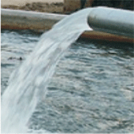
Products in Islamic Microfinance
Salam – Forward Sale
Salam means a contract in which advance payment is made for goods to be delivered later on. The seller undertakes to supply some specific goods to the buyer at a future date in exchange of an advance price fully paid at the time of contract
Utilization
Salam is ideal product for Agricultural Financing, it can also utilize for other business purposes as well.
Currently Practiced:
CWCD, Albarakah MPCS,
Notes:
Bai Salam is an ideal product for Agricultural financing, in which MF1 gives 100% payments in advance to their clients while the deliver of products will be in future agreed dates. Clients may utilize that payment for Agri input, seeds, pesticides, harvesting instruments, irrigation instruments etc.

Slide 9
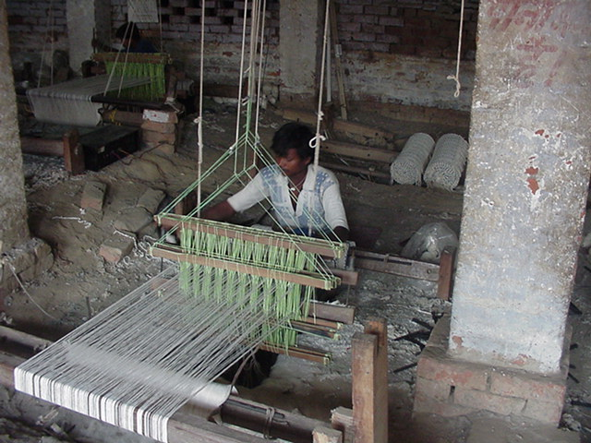
Products in Islamic Microfinance
Istisna - Manufacturing contract
A pre-delivery financing instrument used to finance projects where commodity is transacted before it comes into existence. It is an order to manufacture and payment of price, unlike Salam, it’s flexible, where price may be paid in advance, or in installments or on delivery of good.
Utilization
Istisna May Utilize for small manufacturing Business, for production use, Micro entrepreneur Development sectors etc.
Currently Practiced:
Ghana Islamic Microfinance bank, CWCD, Farz Foundation,
Notes:
Istisna is also same like salam, but in Instisna, it is not necessary to give 100% payment in advance to their client. Istina is an ideal products for manufacturing financing.

Slide 10
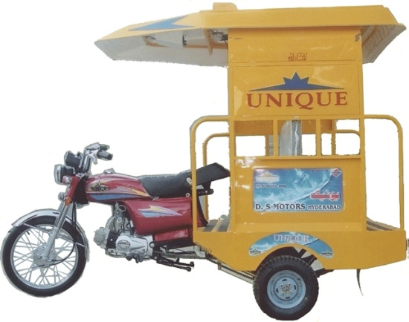
Products in Islamic Microfinance
Ijara – Islamic Lease
Ijarah Means Operating lease. It is an arrangement under which the Islamic Micro Finance Institution lease equipments, light Vehicles, Instruments, buildings or other facilities to a client, against an agreed rental.
Utilization:
Auto Financing, Equipment Financing, House lease etc.
Currently Practiced:
Al-Amal Microfinance Bank, NRDP, CWCD
Notes:
Ijarah mean Islamic lease,

Slide 11
Products in Islamic Microfinance
Diminishing Musharkah
Diminishing Musharkah is a form of Musharakah where the MFI and his client participate in a joint commercial enterprise or property. This attains the form of undivided ownership of both the financier and the client. Over certain period the equity of financier is purchased by the client
Utilization
This is an ideal product for Housing Finance sector, but also utilize for other ventures as well.
Currently Practiced:
CWCD, Ariana Financial Services, Helping hands etc
Notes:
DM is hybrid product, it is combination of Ijarah and Musharakah.

Slide 12
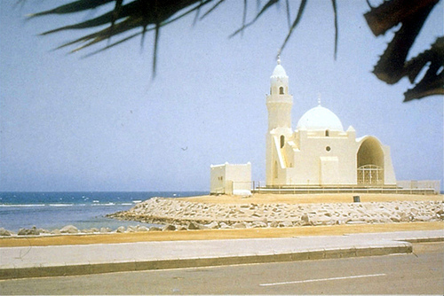
Products in Islamic Microfinance
Other Products
Qard-e-Hassana Model, Waqf Model, Zakhat Model, Cooperative Model, Micro Takaful ( Islamic Micro insurance )
Utilization:
Qard-e-Hassana : for Emergency Loan, benevolence loan, Student, Maternity etc
Zakat : Health, Shelter, Safety net programs, Education and where Zakat applicable.
MicroTakaful: Micro Risk Management, Crop & Livestock Insurance etc.
Currently Practiced
AIMS- Malaysia, Akhuwat, Awqaf South Africa , Al-Amal
Microfinance bank etc
Notes:
There are some other models and products which are being utilize for the strengthening the Islamic Microfinance Industry.

Slide 13
Market for Islamic Microfinance Products
Salam, Istisna and other products
Non-Poor
Transitory Non-Poor
Transitory Vulnerable
Qarz-e-Hasan, Murabahah, Ijarah, Mudarabah
Transitory Poor
Chronic Poor
Zakat, Sadqa, Ushar
Extremely Poor
Notes:
In this slide we will learn that what islamic Microfinance Product will be ideal for what sector, We can categories poverty into Six level
13

Slide 14
Factors to be considered while doing IMFs
Poverty Alleviation Element
and more….
Moral
Ethical
Social
Micro Takaful
A Misconception removed
Islamic Microfinance is a system not the Religion, it can be utilized & operated by both Muslims and
Non-Muslim Communities for Poverty Alleviation, Social & Economic Development.
Free from Interest
Financing
Free from Gharar
Ensure Shariah Compliance
Islamic
Micro
Finance
Shariah Complaints Funds
Shariah Vetted Products
Trainings & Quality HR
Shariah Complaints Investments
Notes:
There are certain factors to be considered while doing Islamic Microfinance…………….
But at this stage, I would like to rectify one misconception that islamic Microfinance is for Muslims, Basically …….. So Islamic Microfinance is not only Muslim worlds but also for whole world.
Shariah Complaints funds: it is necessary for Islamic Microfinance Institution to have shariah complaint fund in Asset side & liability side.
Shariah vetted products according to AAOIFI guidelines.
Trainings & Quality HR: This is very important element for Islamic Microfinance Institutions.
Ensure Shariah Audit: There should be qualified Shariah Advisor, Shariah Review etc.
All the Financing should be free of interest.
Micro Takaful: which is the mechanism of of Shariah compliant insurance.

Slide 15
Demand for Islamic Micro Finance
Research Studies by International Institutions.
Survey by | Surveyed Countries | Respondents Preference (%)
CGAP 08 | Jordan, Algeria, and Syria | 20% - 40%
PlaNet Finance 07 | West Bank and Gaza | 35% - 60 %
USAID 02 | Jordan | 24.9%
IFC/FINCA 06 | Jordan | 32%
Frankfurt School of Fin & Mgmt 06 | Algeria | 20.7%
IFC sponsored Study | Yemen | 40%
IFC 2007 | Syria | 43%-46%
Bank Indonesia 2000 | Indonesia (East Java) | 49%
AlHuda-CIBE | Pakistan (4 Districts) | 99%
Notes:
Here are some research studies which are conducted by International Institutions which shown an appetite of Islamic Microfinance Products especially in Muslim Majority countries. According to CGAP Survey in 2008 in Jordan, Algeria and Syria, the 20 – 40% respondents gave preference to Islamic Microfinance, in 2007 the PlaNet Finance Survey in West bank and Gaza, the 35-60% respondents Preferred Islamic Microfinance. The same situation resulted from other surveys which were conducted by IFC, USAID, Frankfurt School, IFC in Jorden, Ageria and Yemen etc.

Slide 16
Current Status of Islamic Microfinance Industry
300 Islamic Microfinance Institutions operating in 32 Countries
USD 800 Million Market Size.
1.4 Million Active financing Clients.
Murabahah & Qarz-e-Hasan are the Major Products.
Pakistan leading the Islamic Microfinance Clients with 200000+ active Islamic Microfinance Clients with 14 Islamic Microfinance Institutions

Slide 17
Islamic Microfinance Institution Worldwide
Germany:2
- Muslim Society
Switzerland: 2
UK: 5
- HSBC Amanah
- Muslim Aid
- Islamic Relief
Faith Matters
- The Halal Mutual Investment Company
.
UAE: 4
- Dubai Islamic Bank
- Abu Dhabi Islamic Bank
- HSBC Amanah
Kuwait: 2
- Kuwait Finance House
United States: 3
Helping Hands
ISNA
Lariba
Bahrain: 2
Family Bank
Afghanistan 9:
- FINCA , WOCCU
- CHF
Ariana
Iran: 8
Pakistan: 11
India: 3
Bangladesh:9
Turkey: 2
- Faisal Finance Institution
- Ikhlas Finance House
Egypt: 3
- Alwatany Bank of Egypt
- Egyptian Saudi Finance
Malaysia: 11
2 - Pure Islamic Banks (Bank Islam, Bank Muamalat)
Rest - banks
Sudan: 13
Yemen: 05
Al- Amal
Al Kuraimi
South Africa
Awqaf SA
Indonesia: 133
BPRS , BMT.
Muaritius
AlBaraka MPCS
IMFI’s Worldwide: 300 * in Countries: 32
Notes:
Right now near about 300 Islamic Microfinance Institution are working globally in 32 countries. There are 14 IMFI working in Pakistan, yemen have .. Etc. Glimpse

Slide 18
Some Islamic Microfinance Institutions - Worldwide
Countries | Islamic Microfinance Institutions
Indonesia | BPRS, Muslim Aid, Islamic Financial Cooperatives referred as bait Maal wat Tamwil (BMT)
Bangladesh | Islamic Bank Bangladesh, Social and Investment Bank,Al-Fallah and Rescue
Afghanistan | FINCA , WOCCU, Ariana Financial Services , IFIC, Islamic Relief etc.
Pakistan | Akhuwat , Farz Foundation, ASASAH, Muslim Aid, Islamic Relief, CWCD, ,HHRD , NRSP, NRDP, Naymet etc.
Malaysia | Amina Itikhar, Tabung Haji etc
India | AICMEU, BASIX, Sahulat, Bait-un-Nasr , Al-Khair Co-operative, Marwar Shariah Credit
Azerbaijan | Bait –un Nasr
Egypt | Mit Ghamar Project
Syria | Sanadiq project Jabal al Hoss
Lebanon | Mu’assat Bayat Al-Mal
Yeman | Hodeidah Microfinance Program, Al-Amal Microfinance Bank etc, Al Kurumi Microfinance.
South Africa | Awqaf South Africa
U.K | Faith Matters, Islamic Relief, Muslim Aid, HSBC Amanah
Jordan | Jordan Islamic Bank
Notes:
Here we have the country wise detail of some Islamic Microfinance Institutions worldwide.

Slide 19
Pakistan as Leader of Islamic Microfinance Industry
Institution | Mode of Finance
Akhuwat | Qaraz-e-Hasna, MicroTakaful, Grants
CWCD | Murabahah, Ijarah, Salam & Istisna MicroTakaful
NRSP – KPK | Murabahah Mudarabah with BOK for funding Source
Farz Foundation | Murabahah, Musharakah, LIvestock
Islamic Relief | Murabahah and Qarz-e-Hassan
KKCB | Murabaha and MicroTakaful
Helping Hand for RD | Murabahah, Mudarabah
Muslim Aid | Murabahah
NRDP, Deep Foundation, NGO world, Al Noor Foundation | 5 MicroTakaful Co, 5 Full fledge Islamic Banks, 13 SAIBB

Slide 20
Compatibility IMF Products with MF Models
Grameen Model: Amna Iftikhar – Malaysia, Islami Bank Bangladesh Limited etc.
Village Bank Model: Sanadiq program -Jabal al-Hoss, Syria, FINCA - Afghanistan etc.
Credit Union Model: Muslim Credit Union (Tobago), The Amwal Credit Union etc.
Cooperative Model: AlBaraka MPCS – Mauritius, Al- Khair Coop. – India, Muslim Community Coop.– Australia, Karakorum Cooperative Bank – Pakistan.
Self-Help Group: Aameen Society - India
For Profit Banks/MFIs : Ghana Islamic Microfinance Banks – Ghana, HSBC Amanah – U.K, Bank Islami - Pakistan
`

Slide 21
Need Assessment of Islamic Microfinance
Approximately 44% conventional microfinance clients worldwide reside in Muslim countries
Almost one-half of the 56 IDB member countries in Asia and Africa are classed as United Nations Least Developed Countries (LDCs),
Islamic Asset-based Financing – can prevent diversion of funds for consumption.
For Muslim majority countries great need for Islamic Micro Finance exists and large target segment is averse to the interest based microfinance products.
Islamic Microfinance have proven track record that its deals with long lasting & Complete solutions for Sustainability.

Slide 22
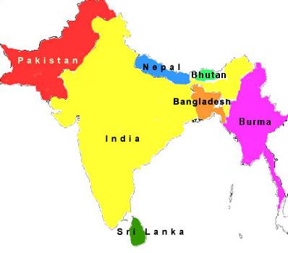
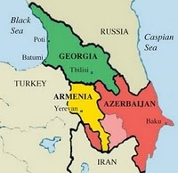
Need Assessment of Islamic Microfinance for
Central Asia, the Caucasus, and South Asia
Central Asia
South Asia
Caucasus
Countries | * Muslim Population | %
Kazakhstan | 8,887 | 56.4
Kyrgyzstan | 4,927 | 88.8
Tajikistan | 7,006 | 99.0
Turkmenistan | 4,830 | 93.3
Uzbekistan | 26,833 | 96.5
Aggregate | 52,483 | 85.5%
Countries | * Muslim Population | %
Bangladesh | 148,607 | 90
Bhutan | 7 | 1
India | 177,286 | 14.6
Maldives | 309 | 98.4
Nepal | 1,253 | 4.2
Pakistan | 178,097 | 96.4
Sri Lanka | 1,725 | 8.5
Afghanistan | 29,047 | 99.8
Aggregate | 536,331 | 33.2%
**Countries | * Muslim Population | %
Armenia | 1 | <0.1
Azerbaijan | 8,795 | 99.2
Georgia | 423 | 9.9
Stavropol Krai | - | -
Krasnodar Krai | - | -
Aggregate | 9,219 | 70%
* According to 2010-11 & .in figure 000 ** Appropriate data is not available for North Causasus
Notes:
Lets take a glimpse of Need Assessment of Islamic Microfinance for Central Asia, the caucasus and South Asia. In Central Asia we are seeing a big Muslim Popoultaion. In Central Asia………….
This concludes a great potential and requirement for Islamic Microfinance in these regions
http://en.wikipedia.org/wiki/South_asia
http://en.wikipedia.org/wiki/Central_Asia

Slide 23
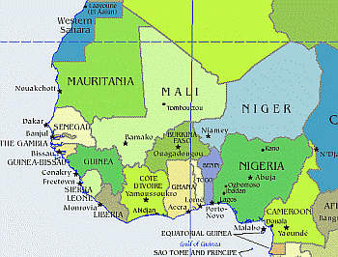
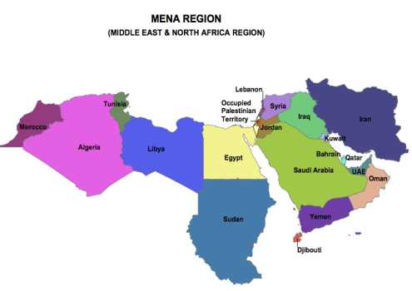
Need Assessment of Islamic Microfinance for
West Africa and MENA Region
West Africa
MENA Region
(Middle East & North Africa Region)
Countries | * Muslim Population | %
Benin | 2,259 | 24.5
Burkina Faso | 9,600 | 58.9
Cape Verde | < 1 | 0.1
The Gambia | 1,669 | 95.3
Ghana | 3,906 | 16.1
Guinea | 8,693 | 84.2
Guinea-Bissau | - | -
Liberia | 523 | 12.8
Mali | 12,316 | 92.4
Mauritania | 3,338 | 99.2
Niger | 15,627 | 98.3
Nigeria | 75,728 | 47.9
Senegal | 12,333 | 95.9
Sierra Leone | 12,333 | 95.9
Senegal Sierra | 12,333 | 95.9
Togo | 827 | 12.2
Aggregate | 171,485 | 57.8%
Countries | * Muslim Population | %
Algeria | 34,780 | 98.2
Bahrain | 655 | 81.2
Egypt | 80,024 | 94.7
Iran | 74,819 | 99.6
Iraq | 31,108 | 98.9
Jordan | 6,397 | 98.8
Kuwait | 2,636 | 86.4
Lebanon | 2,542 | 59.7
Libya | 6,325 | 96.6
Morocco | 32,381 | 99.9
Oman | 2,547 | 87.7
Qatar | 1,168 | 77.5
Saudi Arabia | 25,493 | 97.1
Syria | 20,895 | 92.8
Tunisia | 10,349 | 99.8
UAE | 3,577 | 76.0
Yemen | 24,023 | 99.0
Aggregate | 359,719 | 97.3%
* According to 2010-11 & .in figure 000

Slide 24
Need Assessment of Islamic Microfinance for
Central Asia, the Caucasus, and South Asia
FINDINGS
Total Population of South Asia, Central Asia, West Africa and MENA Region & Caucasus are 2.4 Billion , out of them 1.12 Billion are Muslims which are 47.3 %, and shows a big Demand of Islamic Microfinance Products for Financial Inclusion because Muslim are reluctant to move Interest based MF System.
IMF is beneficial for Muslim as well as for Non-Muslims.
According to World bank*, South Asia is home to half the world's poor, where Muslim population is 33.2% of total population, which shows immediate need of Islamic Microfinance there.
* Source World Bank – South Asia

Slide 25
Challenges faced by Islamic Microfinance
Non - Availability of Donor/Shariah Compliant Sources of Funds
Need to develop a uniform regulatory and legal framework for the Islamic Microfinance Institutions.
Accounting & I.T systems., Rating Agencies.
Lack of Quality HR in Islamic Microfinance Sector.
Standardization of Islamic Microfinance Products.
Reluctance in Research & Implementation of new Products, as only (Murabahah) is serving almost 80% of Islamic Microfinance Industry.
Development of Shairah Expertise towards the Growth of Islamic Microfinance.
Policies & Regulations on Zakat & Awqaf.
Notes:
Recently, IMFI’s are facing some challenges which need the to address. 1) This is the biggest challenge which is now faced by IMF Industry, this is also the hurdle in the way of its scaling up. 3) due to limited IMFI, we are also facing the shortage of quality HR in this sector. 4) if we see the product mix of Islamic Microfinance industry, we discovered that only Murabahah is covering almost 80% Microfinance Industry, so there is an immediate need of research on other Islamic Microfinance Products as well for products diversification.

Slide 26
Opportunities for Islamic Microfinance
International Islamic Microfinance Network (IMFN) for an effective interface and Coordination among IMFI’s
Expansion of Market where the Conventional MFI’s face limitations especially in Muslim Majority Countries
AlHuda Centre of Excellence in Islamic Microfinance is offering all Islamic Microfinance Solution.
A Trend in diversion of donors funds to more ethical objectives
IDB - Microfinance Development Program (MDP )
Islamic Banking and Finance is emerging in South Asia, Central Asia & MENA region which will strengthened the Islamic Microfinance effectively.
Notes:
IMFN was established in 2009 by Islamic Microfinance institutions to strengthened & support the Islamic Microfinance institutions and to bring them to a common platform.
My Institution, AlHuda-Centre of Islamic Banking and Economics has also set up since 2008 a Help Desk for Advisory and Trainings and Capacity Building for Microfinance Institutions. We provide complete solutions in Islamic Microfinance covering………..

Slide 27
JazzakAllah
Thank you for listening with patience
Muhammad Zubair Mughal
Chief Executive Officer
AlHuda Centre of Islamic Banking and Economics
Zubair.mughal@alhudacibe.com
www.alhudacibe.com

