Slide 1

MFI INSIGHT Analytics Alhuda Workshop Records track and Resources
Commercial-in-confidence
Not to be disclosed without prior written permission
by authorised executives of MFI Analytics and ANIMF

Slide 2







MFI Insight Analytics presentation
15th
anniversary
2 locations
1 continent
1 founder et 4 parteners
With more 50 years BI experiences
In Europe , Africa, USA et Asie
International partner network
( Paris , London , DRC , Kenya, Uganda, Morocco)
+20 consultants
50 achieved
projects for more 15 clients
missions achieved in 6 countries différents
Over 3 continents

Slide 3




























TRACK RECORD
Providing impact to the largest players with the state of Art technology
Technology
Trusted by the top global players

Slide 4

What MFI Insight Means for Banks and FI
Bank
Growth
Quality
Profitability
Composition
Finance Analytics Platform
Financial Analytics Module (FAM)
FAM helps you to better manage your Loan Portfolio on daily performance in micro-markets. It’s also a process that fosters cross-department collaboration.
360 Customer Centricity Module (CCM)
Helps you to better manage you customer interaction - KYC
How to build a Customer loyalty and prevent Churn
Measure the Social Impact of your service toward your customer
Channel & Network performance Module (CNM)
Product Performance
Module (PPM)

Slide 5
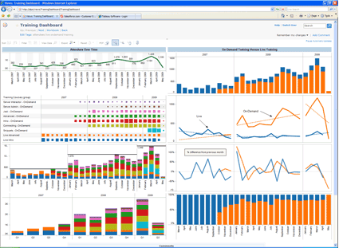






Features Overview Solution Architecture (1/2)
Banking
Model
Channel
Loan Portfolio Management
360 Customer
Accounting
ATM Switch
Core Banking
Mobile
Banking
CRM

Slide 6
Loan Portfolio Management: Performance Monitoring (1/3)
Portfolio Analysis View
Summary | Risk & Aging & Vintage | Concentration | Trends | Exposure | Benchmarking
Indicators Total Balance Delinquency Outstanding Balance at Risk | Score Days Beyond terms Delinquency /Aging | Industry Geography/ Region Size of Business Years in Business Loan officer Product | Score PAR LAR Days Beyond term | Provides list of companies at risk Or corporate linkage | Region Industry Product

Slide 7
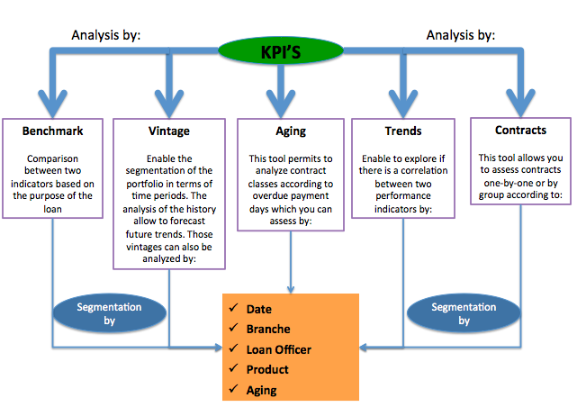
Loan Portfolio Management Good Monitoring and Efficient Reporting
An accurate knowledge of your portfolio and the ability to make relevant analysis is necessary to enhance your operations and take strategic decisions.

Slide 8
Our value proposition
Pre-packageable analytics insights
Key actionable business questions ready to deploy for FI and small medium banks. On cloud or Premise
Minimal project risk, reduced implementation time cycle less than 6 weeks
Predefined Canonical model
A set of predefined KPI that support Loan portfolio management, channel and customer intelligence. Data Model and Finance Repository.
Agile technology
Transformations build on Easy to adapt and implement to any type of STACK MS This integration provides an efficient, accurate and transparent process for delivering Finance measures

Slide 9
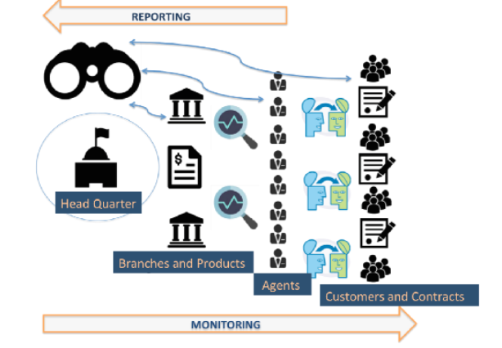
3.3 Monitoring
Agile solutions provide an insights to all levels of the hierarchy in the organizations
Better monitoring lets you take appropriate decisions
Allows you to make forecasts through accurate analysis with various granularity levels

Slide 10
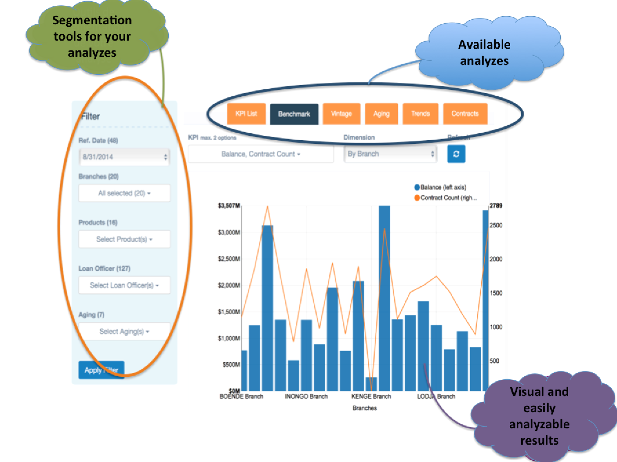
3.2 Loan Portfolio Management Deep analysis with predictive Measurement
Loan Portfolio Performance monitoring
Balance analysis
Delinquency per Aging
Outstanding Balance at Risk
Concentration Analysis-(region –business)
Vintage analysis
Benchmark analysis &Trend analysis
Per Branch
Per product
Per Industry
Credit Scoring System ( application – Behavioral )
Write-off and recovery tracking-
Workflow management

Slide 11
Our Cloud Based Package
Loan Portfolio Management
Credit Scoring
Key Performance Indicators
Trends analysis
Workflow Management
Alerts follow up.
Low income
Individual
SME
No licence to pay
Modulable to your needs
Easy to implement in your organization
A support team at your disposal

Slide 12
Our Offer
First Year |  | Following Years
10 KPI's |  | 10 KPI's
Credit Scoring Tool |  | Credit Scoring Tool
10 users |  | 10 users
12 hours of support |  | 4 hours of support
Extra Workflow Management |  | Workflow Management
Extra User |  | Extra User
Extra KPI |  | Extra KPI
Extra Support Hour |  | Extra Support Hour

Slide 13
Recap :MFI Analytics Canonical Model Overview
Date
Loans
Accounts
Party
Branch
Contracts
Customer relationship
Collateral
Recoveries
Customer
Region
Aging
Write-offs
Employee
Location
Accounts-Balance
Product
Guarantor
Transactions
Channel
Financial
Scoring
Currency
Revenue
Chart of Accounts
Internal info
Expenditure
External info
Rate
GL
MFI Insight Standard canonical Model

Slide 14
Recap Solution Architecture
Applications giving end-users access to the data in Cubes web-based and adapted to their needs (querying, reporting, analysis, mining…)
Visualisation Layer
Master / Meta Data Layer
End-user views on detailed and aggregated data of the Integration Layer (traditionally organized into facts and dimensions) and materialized into data marts
Analytical Layer
Error Management & Manual Input Layer
Centralized repository of current (LDM) Logical Data Model and historical (EDW) enterprise-Data Warehouse
Centralized management of data warehouse processing errors and possibility to integrate non automated data streams
Calculation Engines Layer
Integration Layer
( canonical Model)
Set of external calculation engines that due to their complexity or processing load are not integrated into the standard source-to-target transformational processing
Functional and technical description of each of the layers, allowing for a better comprehension and exchange of data contained within
Extraction &Transformation & Validation Layer
Temporary area for data staging and transformation prior to publication into the Integration Layer

Slide 15
Thank you for your attention http://vmmfi.cloudapp.net/mfi
MFI Insight Analytics
Email: Yasser.eljasouli@mfianalytics.com
Skype :eljasouli.sidi.Yasser
Congo-Invest Consulting
Teza bila
Tel : +243810810985 / +243991076135
Skype : congoinvestconsulting

