Slide 1

Akhuwat Interest Free Microfinance A Journey of Hope
Junaid Farid
Director, Strategic Planning & International Marketing
Notes:
2 principles
A- true Islamic ideology
B- it would uncompromisingly offer

Slide 2

Akhuwat
An attempt to resolve poverty and social development issues through innovation
Notes:
Good Morning Ladies and Gentlemen. I would like to express my gratitude to the team all the participants and the team of Al-huda who have gathered here today to talk about contemporary issues on Islamic Microfinance and share our respective experiences within a global context. I will be going over the model of Akhuwat, explaining our philosophy, how our model operates along with our progress over the last decade and a half.

Slide 3
History
Akhuwat was established in 2001 with the objective of providing interest free micro-credit to the poor so as to start a business, come out of poverty and enhance their standard of living. Subsequently it added education, health, clothing and some other services in its mandate
‘Akhuwat’ means solidarity with the poor and less advantaged.
Notes:
As discussed by Dr. Saqib, Akhuwat was established to provide interest free loans to the needy in order for them to start an entrepreneurial venture so that they can break the shackles of poverty. The word Akhuwat stems from Brotherhood where we show our solidarity with the poor and less advantaged.

Slide 4
Akhuwat
Vision
A poverty free society built on the principles of compassion and equity.
Mission
To alleviate poverty by empowering socially and economically marginalized families through interest free microfinance, quality education, better health-harnessing entrepreneurial potential and building capacity by imparting knowledge, skills and social guidance.
Notes:
We envision a society that is built on the principles of compassion, equality and sacrifice. And we intend to achieve this vision by empowering the socially and economically marginalized segment of society by offering interest free loans and provide a platform the way provide capacity building in terms of knowledge, skill and social guidance.,

Slide 5
Objectives
To provide interest free microfinance services to poor families enabling them to become self-reliant
To promote interest-free loans (Qarz-e-Hasna) as a viable model and a broad-based solution for poverty alleviation
To provide social guidance, capacity building and entrepreneurial training

Slide 6
Objectives
To institutionalize the spirit of brotherhood, compassion, and volunteerism
To transform Akhuwat borrowers into donors
To make Akhuwat a sustainable, growth-oriented and replicable organization

Slide 7
Core Principles
Interest-free loans – Qard e Hasan
Use of Religious places like mosque & church
Spirit of Volunteerism
Transforming Borrowers into Donors
Notes:
Benevolent loan, bottom pyramid, better chance
History, cost, spiritual bond
Started with a group of 8 vounteers and now has grown to more than 4000 volunteers. We call our staff volunteers, beyond the call of duty, registered volunteers
our model is not one of charity. It is so much more than that. Because we don’t just go to the rich people and ask ‘please give something to the poor; instead we go to the people and ask them to help themselves. For everyone should help rich or poor. Everyone must have the belief that theres always someone in a much worse situation than I am, and that I want to help this person on the basis of humanity and compassion – and that is the true glory of giving.. And that is why we believe that our model is sustainable, growable and not based on doles and charity. Share something with you. As a result of this our believe has ever strengthened in the masses and become unshakable with our will becoming overwhelmeing. And when belief and will come together than there is nothing that cannot be achivened. Every impossible thing comes in reach and that is the society we hope to achive. And that is why we believe that a perfect system cannot simply fall from the sky, it has to come from within the prople from the grassrottos and that is what these numbers show – true inspiration.

Slide 8
Products
Enterprise Loan
Liberations Loan
Agricultural Loan
Education Loan
Marriage Loan
Emergency Loan
Housing Loan
Establishment of School Loan

Slide 9
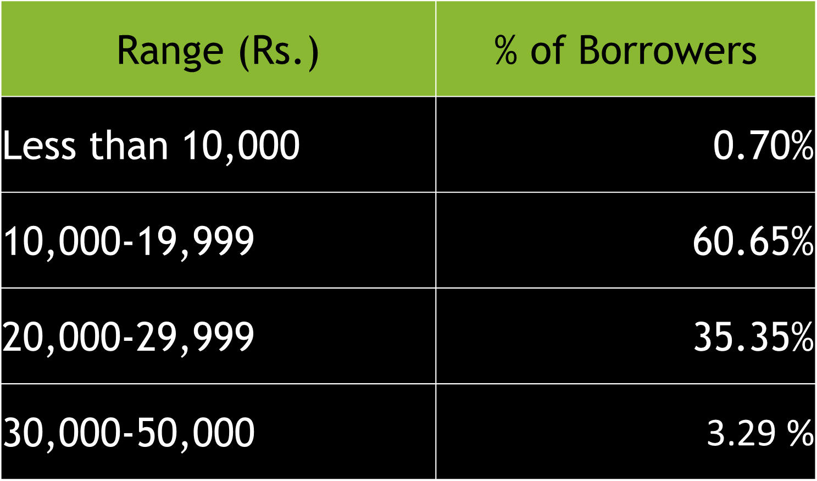
Range of Loans

Slide 10
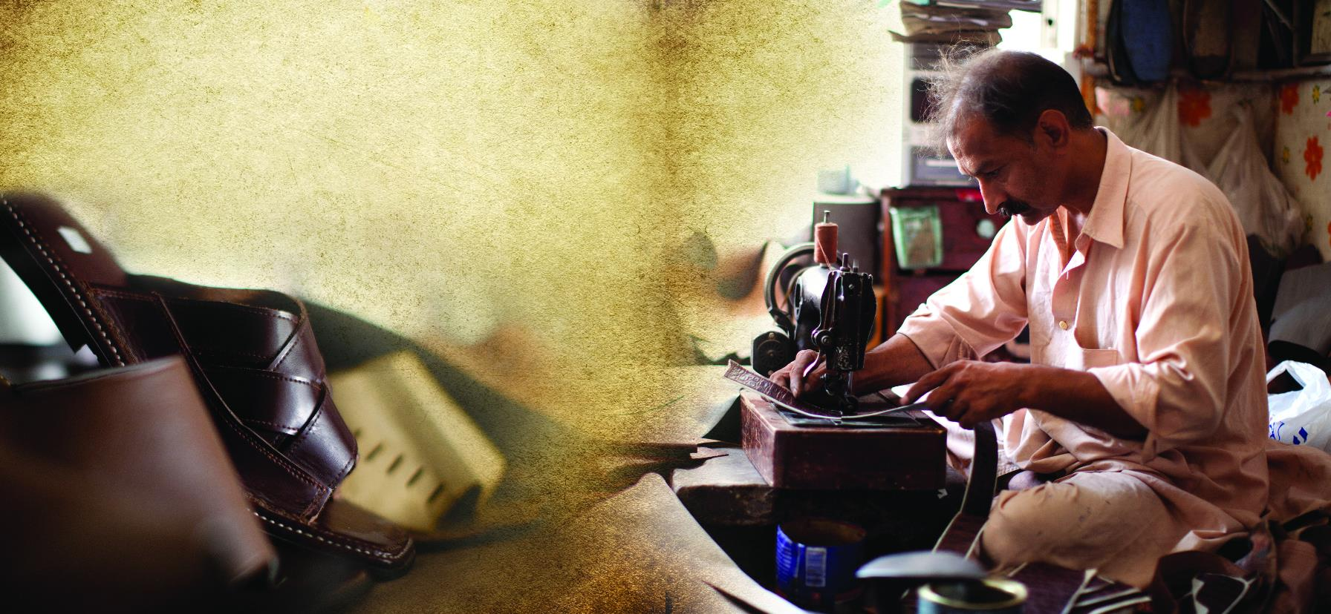
Usage of Loan

Slide 11
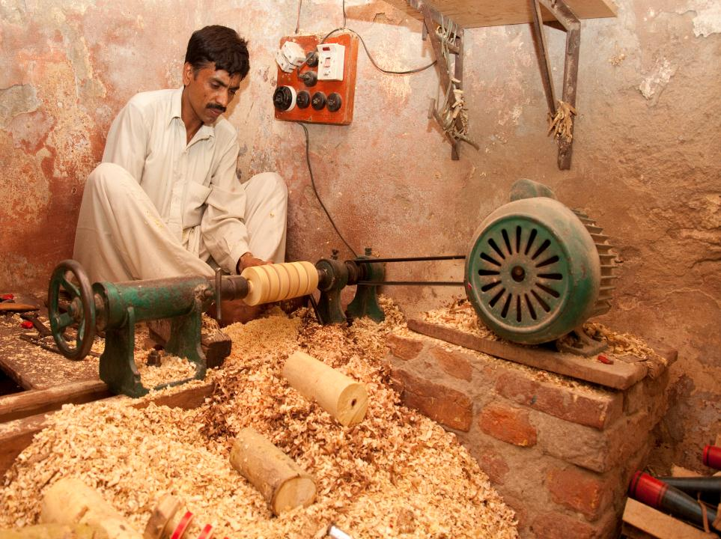


Slide 12
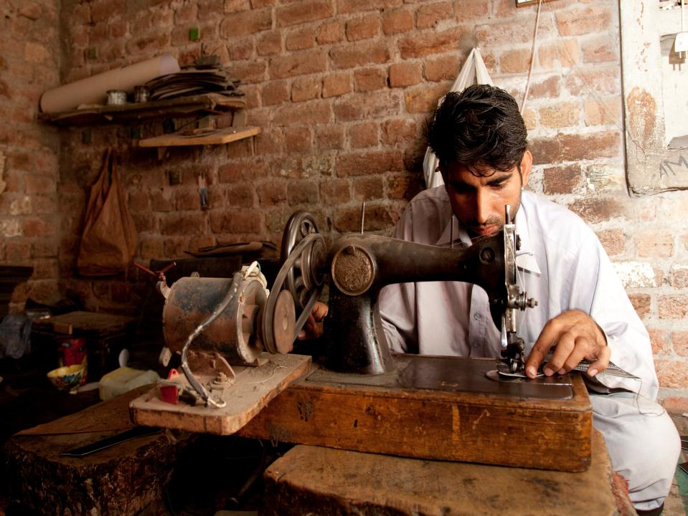

Slide 13
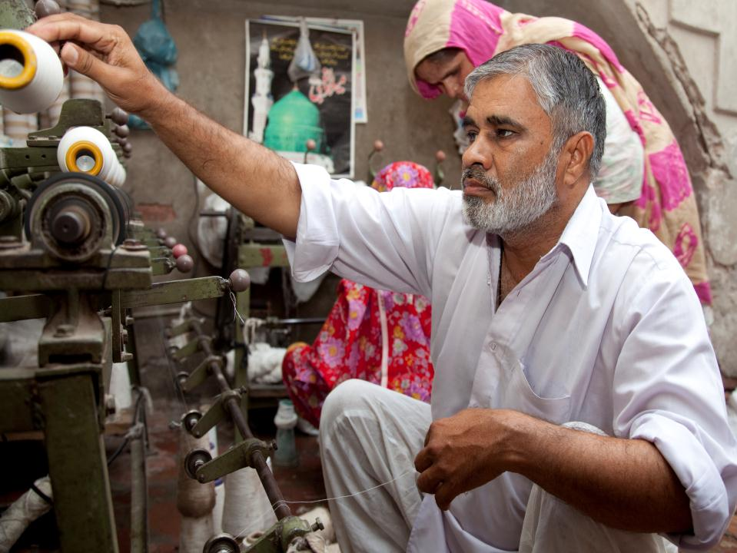

Slide 14
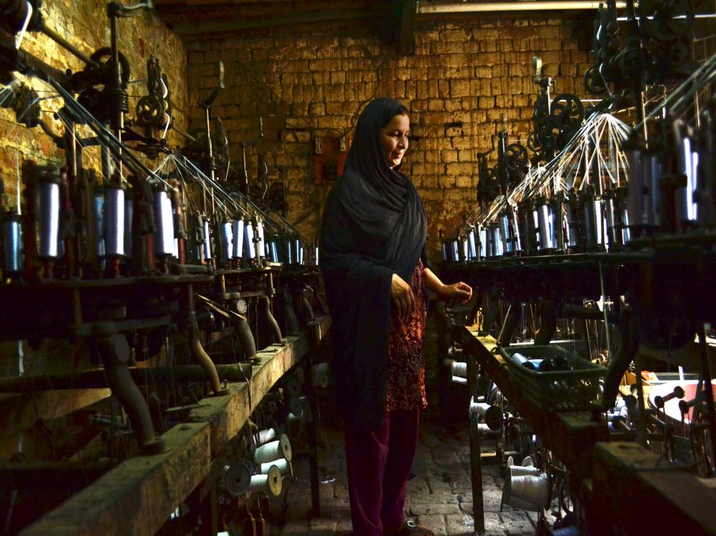

Slide 15
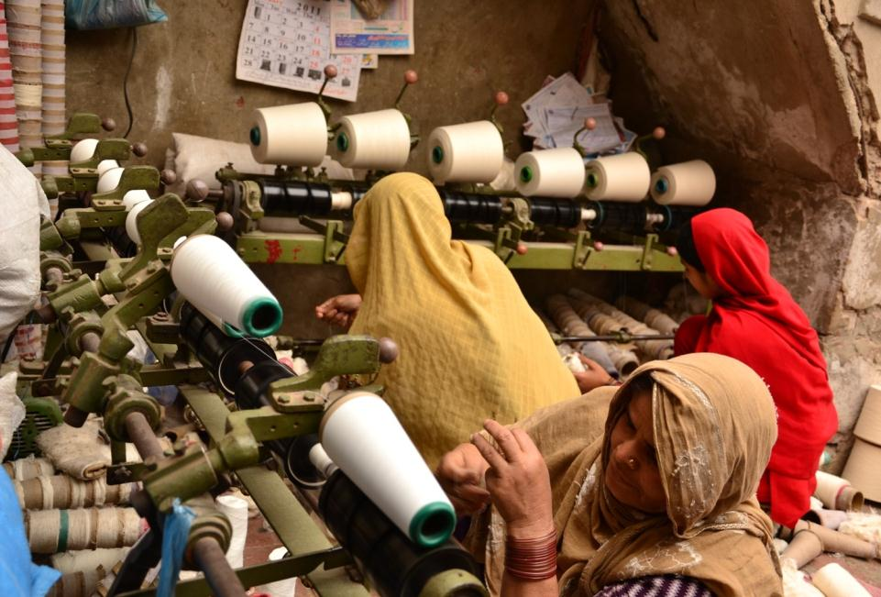

Slide 16
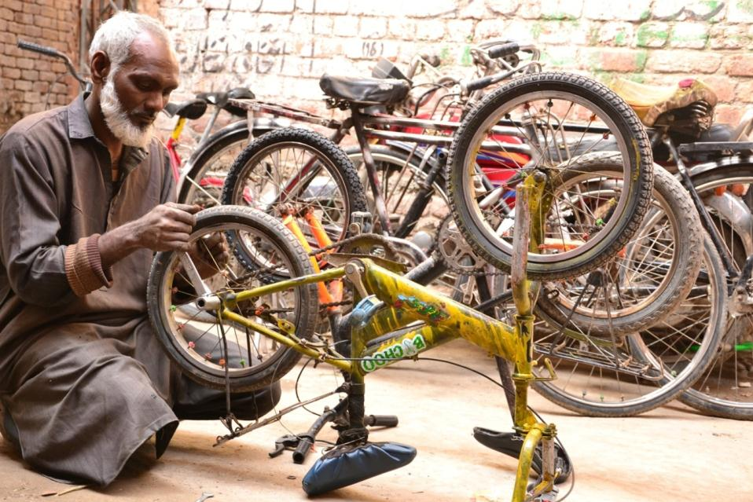

Slide 17
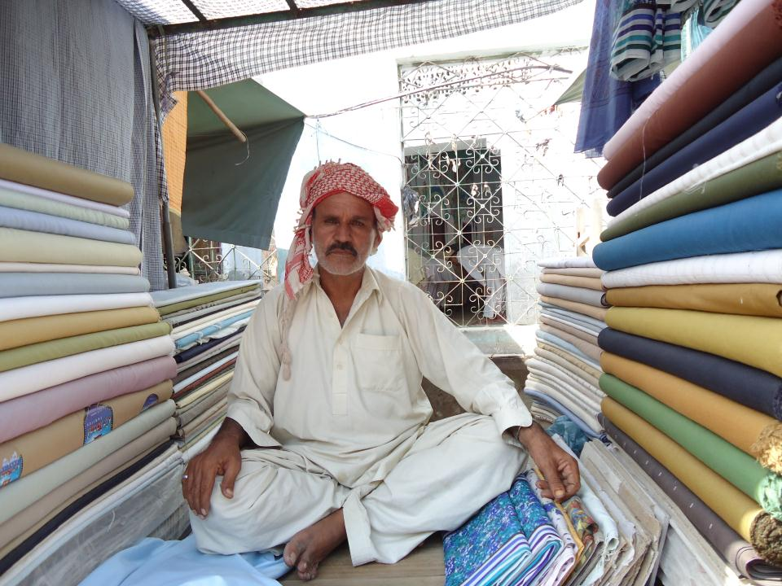

Slide 18
Map of Pakistan

Slide 19
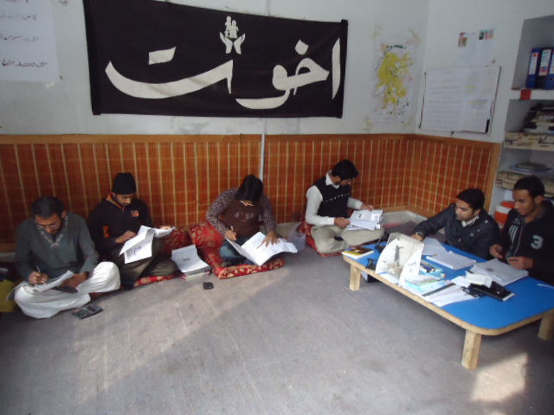

Slide 20
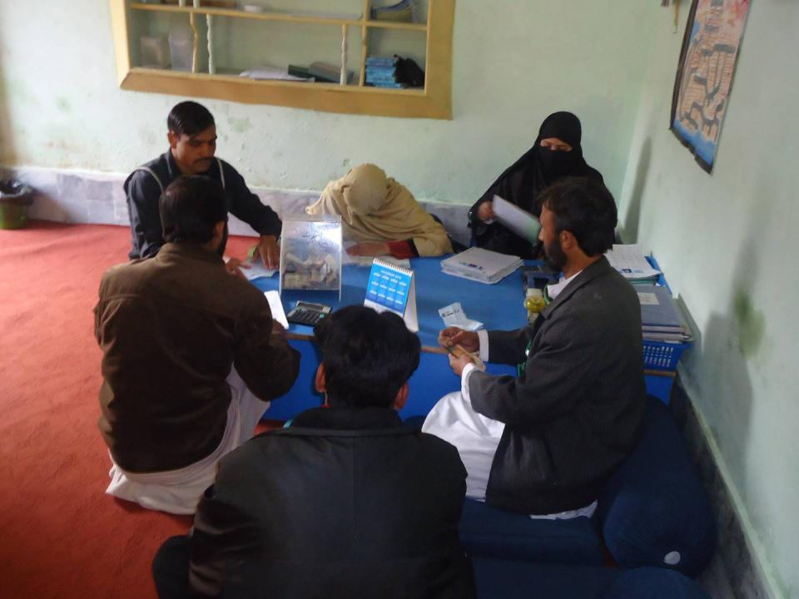

Slide 21
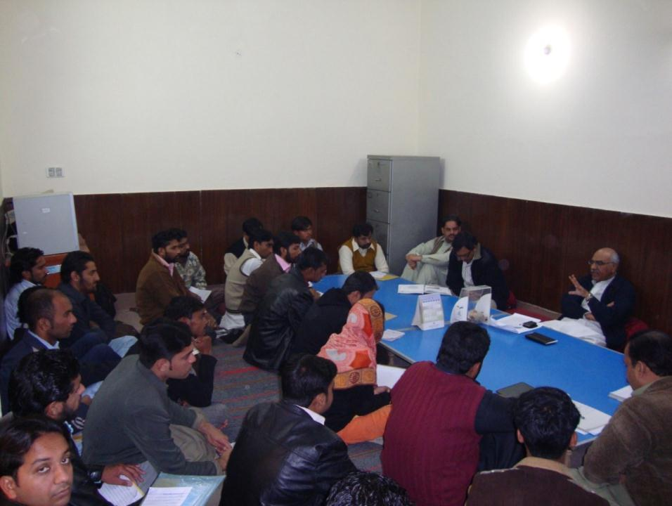

Slide 22
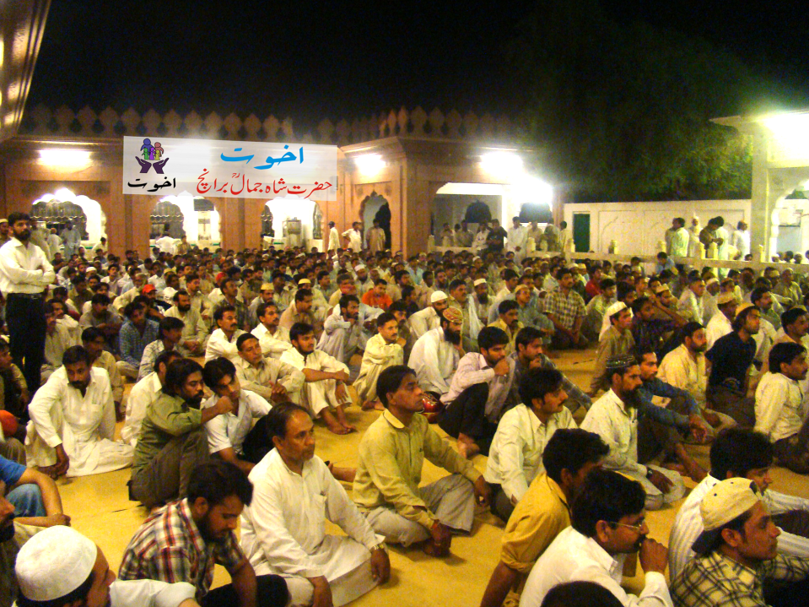

Slide 23
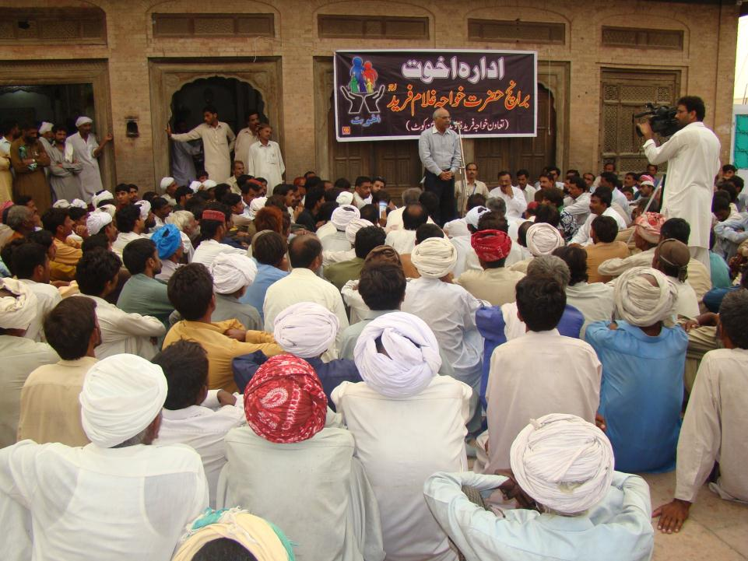

Slide 24
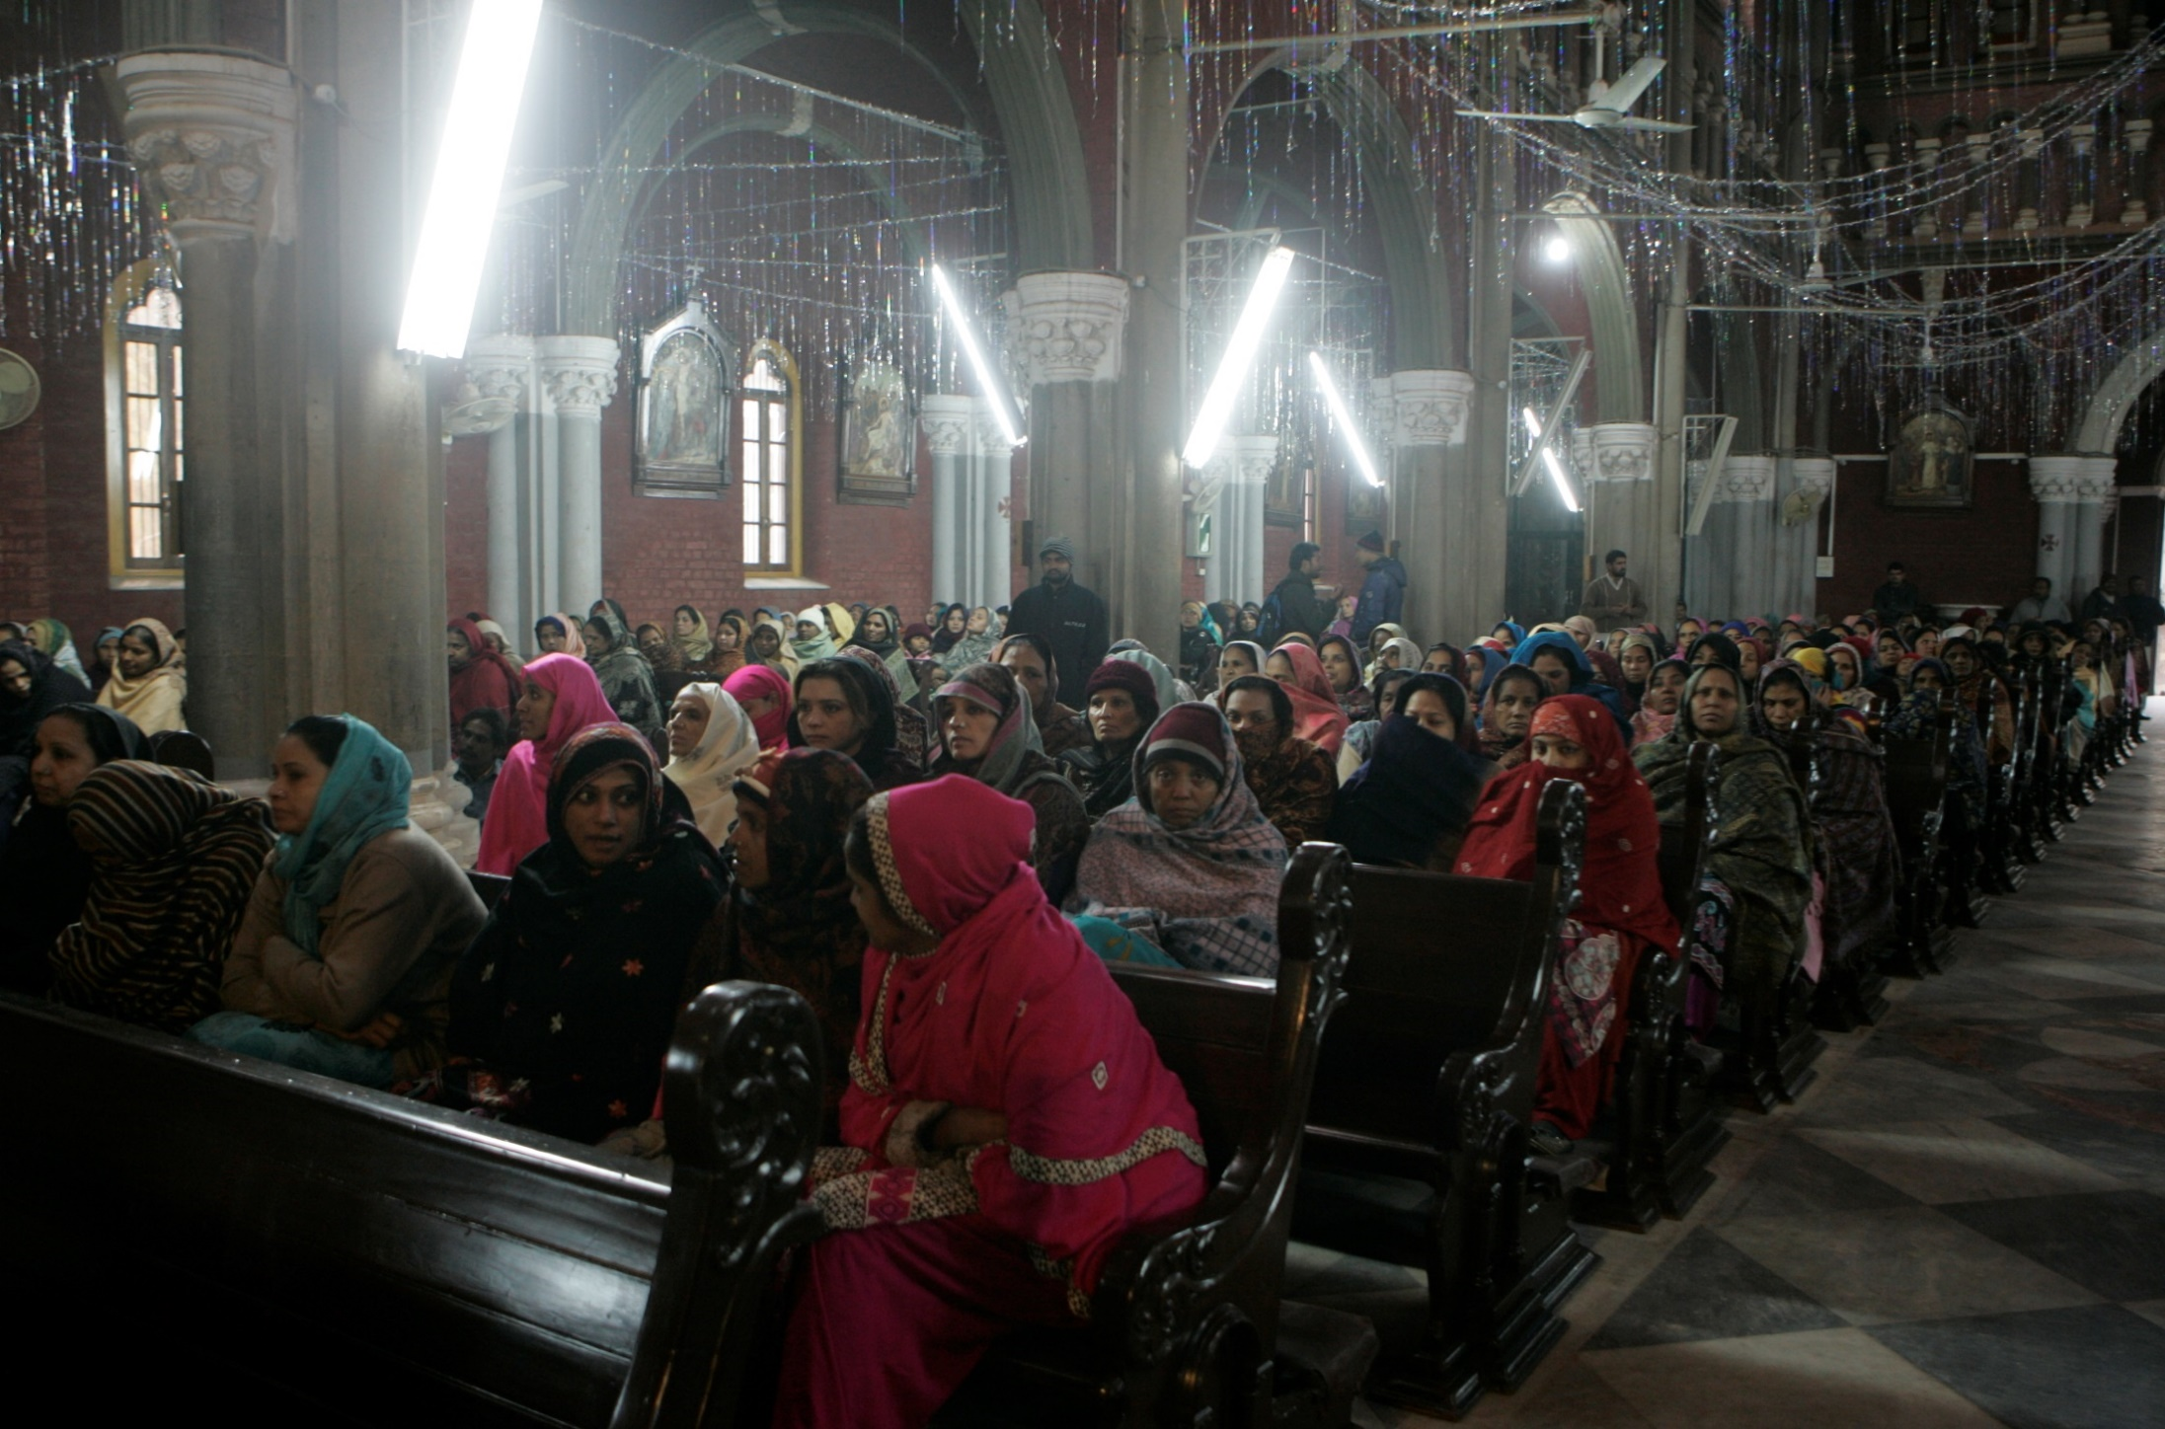

Slide 25
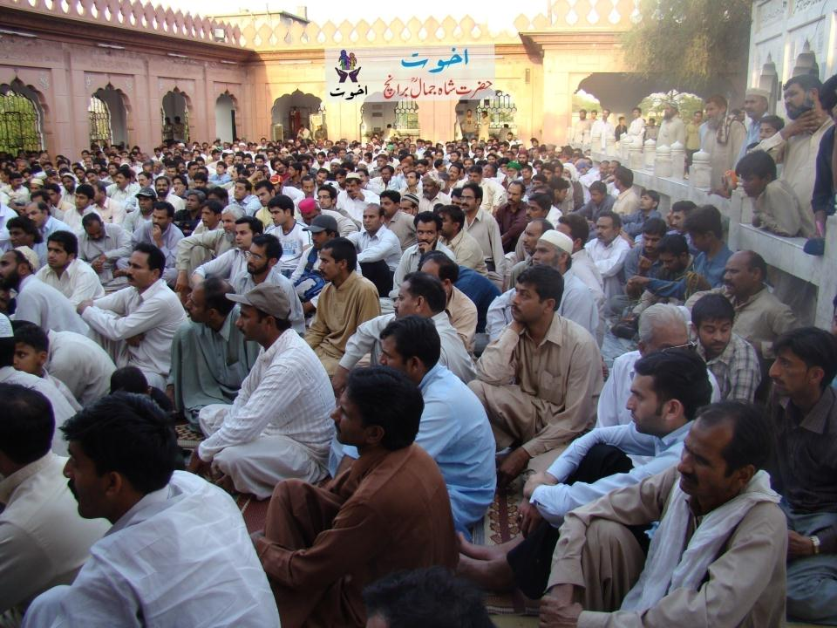

Slide 26
Cost structure of Loans
Loan Structure
Interest on Loan = 0
Loan Processing fee = 0
Profit on Loan = 0
Application Fee = $2
Insurance = 1%

Slide 27
Performance Overview
Started in 2001 with 100 USD
Credit pool has now grown to USD 90 Million
The credit pool is a revolving fund
The amount is regularly disbursed and recovered
Cumulative disbursement is USD 300 Million

Slide 28
Performance Overview
Total Benefiting Families = 1.6 Million
Total Amount Disbursed = USD 300 Million
Active Loans = 600,000+
Number of branches = 508
Number of cities & towns = 300
Number of staff = 3000+
Recovery Rate = 99.8%

Slide 29
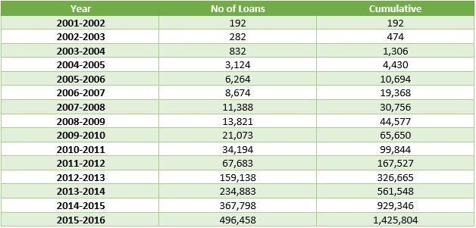
Progress Overview

Slide 30
Progress Overview

Slide 31
Progress Overview

Slide 32
Progress Overview

Slide 33
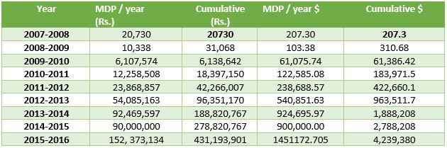
Progress Overview

Slide 34
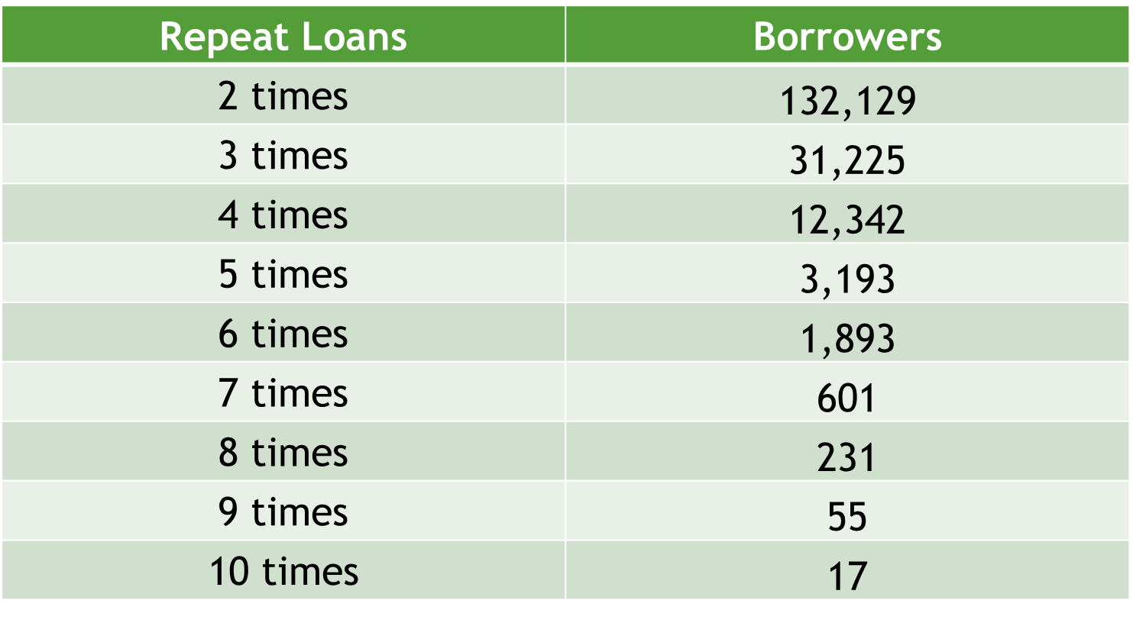
Repeat Loan Analysis

Slide 35
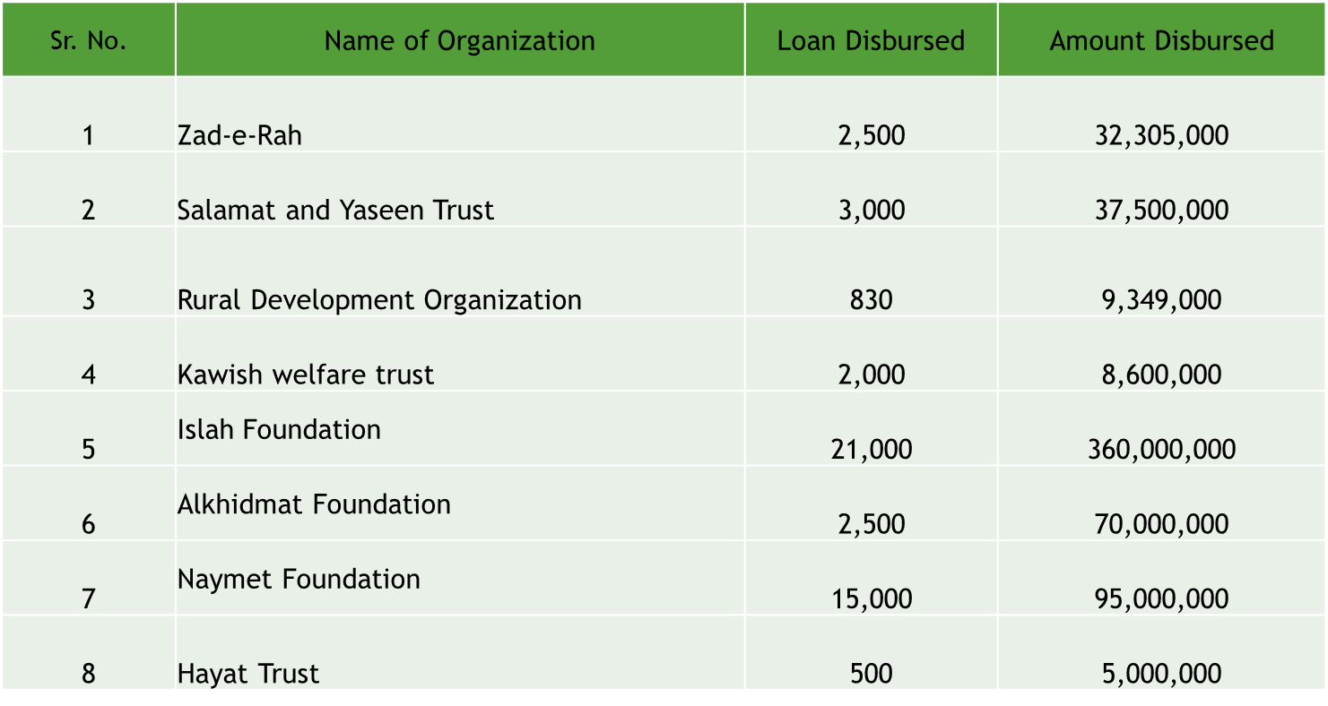
Replication

Slide 36
How to replicate
Introduction of Akhuwat model
Website and promotional material
Training manuals and operational material
Staff training
Visit Akhuwat premises
Continuous technical support

Slide 37
Issues in Replication
Strong Commitment
Financial Resources
Operating at optimum level
Simplicity and keeping costs low
Local conditions
Human Resource

Slide 38
Akhuwat Projects
Akhuwat Institute of Social Enterprise & Management
Akhuwat University
Akhuwat College
Akhuwat Schools
Akhuwat Health Services
Akhuwat Cloth Bank
Akhuwat Make a Dream
Khwajasira Rehabilitation Program

Slide 39
OUR BELEIEF
Poverty alleviation is the joint responsibility of the state and the civil society
Equitable distribution of wealth is a pre-requisite
Charity alone is not the answer
Solidarity with the poor is the way forward
Availability of credit/financial inclusion is a must for all
We derive our inspiration from Islam but our message is universal for all
Notes:
And most of all we believe that this organization, this cause is a symbol of commitments to our fellow brothers, to our fellow neigbours, to our fellow human beings. And this commitment like all others will face the challenge and hurdles of time itself. However, today I, like any other day, I renew my commitment to this cause and to the underprovilidged people of our society - therefrore this commitment shoulf be renvewd ebveryday, with every passing of time so that no matter what we are ultimately able to achieve our objecives by eradicating the menace of poverty from our society,

Slide 40
Discussion
Question and Answer Session

