Slide 1
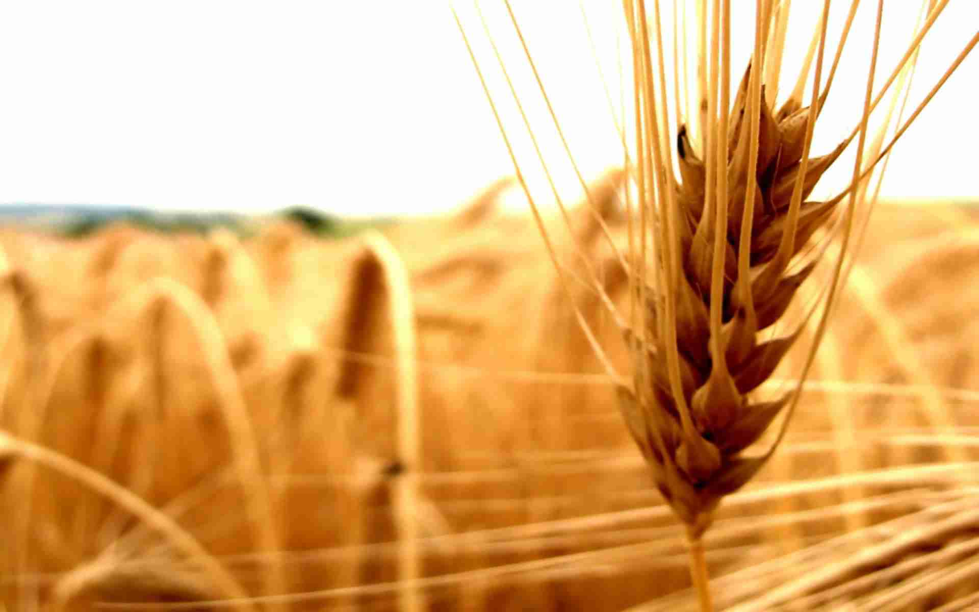
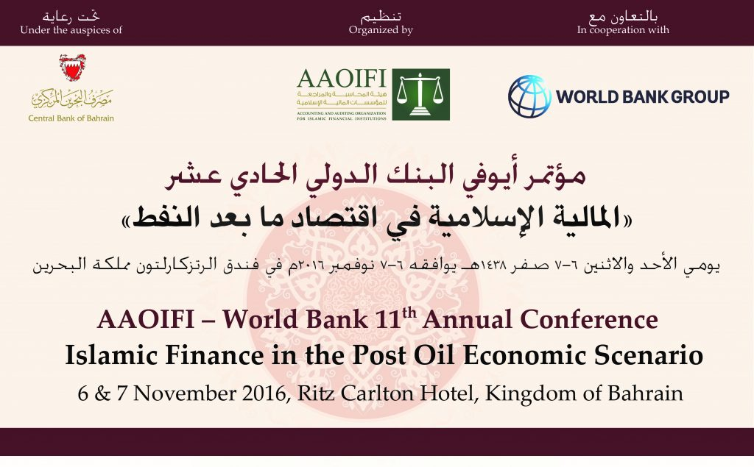



Islamic Agricultural & Rural Finance
Muhammad Zubair Mughal
Chief Executive Officer
Allhuda centre of Islamic banking and economics

Slide 2
Contents
Why Islamic Agricultural and Rural Finance ?
Source of Islamic Agricultural and Rural Finance Product.
Compatibility of Islamic Financial Products with Conventional Rural Credit lending Models.
Opportunities, Challenges and Innovation.

Slide 3

Why Islamic Agricultural & Rural Finance?
Prohibition of Interest – Financial Inclusion
53% of population in the OIC countries live in rural areas – SESRIC - OIC
20% Financial Inclusion in Muslim World – World Bank.
OIC countries occupy 29% of the world agricultural land.
Asset Based Financing & Risk Sharing – Impact.
Takaful ( Islamic Insurance) – Crop, Livestock and Rural
Economy supported Product

Slide 4
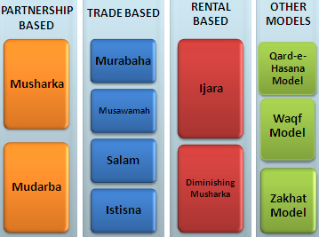
Source of Islamic Agri. Finance Products
Sources of Islamic Finance
Product Mechanism
Quran
Sunnah
Ijma’a (jurist consensus)
Ijtihad & Qiyas (analogy)

Slide 5
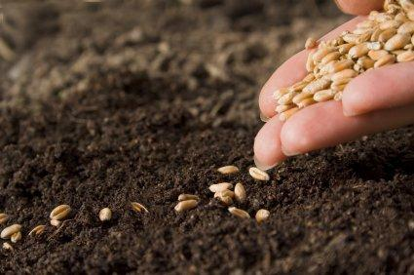
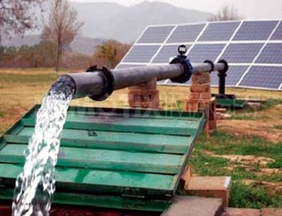

Islamic Agricultural Finance Products
Murabaha – Cost Plus Sale
Murabaha means a sale on mutually agreed profit, also known as cost plus sales, it is one of the most widely used instruments for short-term agricultural financing where the Bank/MFI undertakes to supply specific goods or commodities at mutually agreed profit to the client.
Utilization :
Murabahah can be utilize for Purchase of seed, fertilizer, harvesting and planting equipments, agri. Inputs, tractor, pesticides, farming goods, Solar Tube-wells etc.
Currently Practiced:
MBL and some other Banks, NRSP – KPK, Al Amal Bank, Islamic Bank Bangladesh,
FINCA-AF, Islamic Relief, BMT’s in Indonesia etc.

Slide 6

Islamic Agricultural Finance Products
Salam – Forward Sale
Salam means a contract in which advance payment is made for goods to be delivered later on. The seller undertakes to supply some specific crop/goods to the buyer at a future date in exchange of an advance price fully paid at the time of contract
Utilization
Salam is ideal product for Agricultural Financing, through which a farmer can fulfill all the financial needs of whole crop circle e.g. liquidity, seed, pesticide, fertilizer, harvesting, irrigation, transportation, market linkages etc.
Currently Practiced:
Wasil Foundation, Albarakah MPCS, MBL etc.

Slide 7
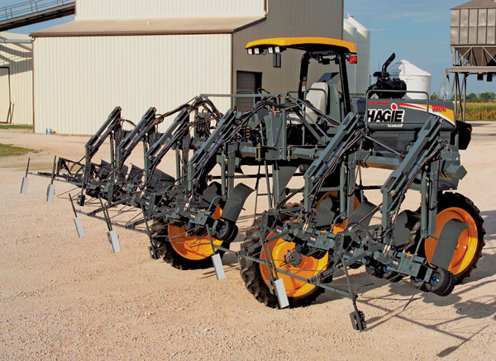
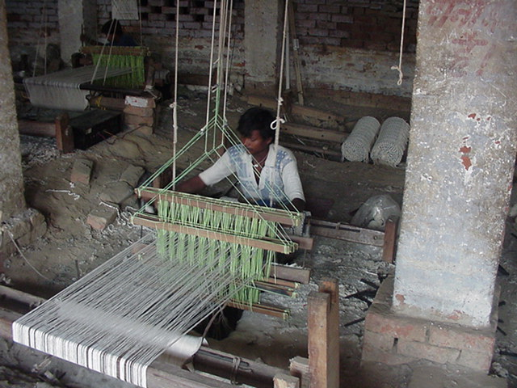
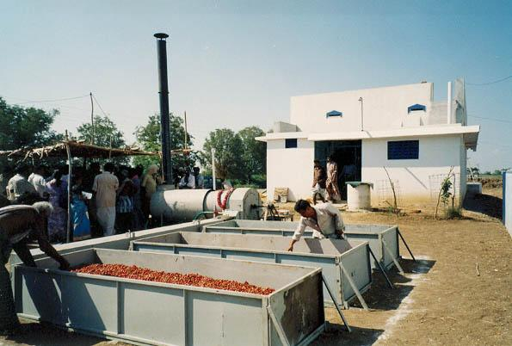
Islamic Agricultural Finance Products
Istisna - Manufacturing contract
A pre-delivery financing instrument used to finance projects where commodity is transacted before it comes into existence. It is an order to manufacture and payment of price, unlike Salam, it’s flexible, where price may be paid in advance, or in installments or on delivery of good.
Utilization:
Istisna May Utilize for small manufacturing Business, dairy or Agri. production, Construction of wharehouses and cold storage, Rural entrepreneur Development etc.
Currently Practiced:
AlBaraka MPCS, Ghana Islamic Microfinance bank,
Al-Amal Bank, Bank of Khartoum etc.

Slide 8

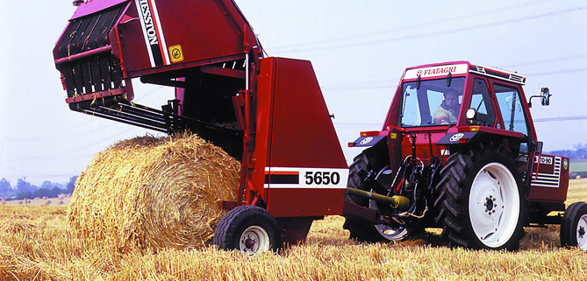
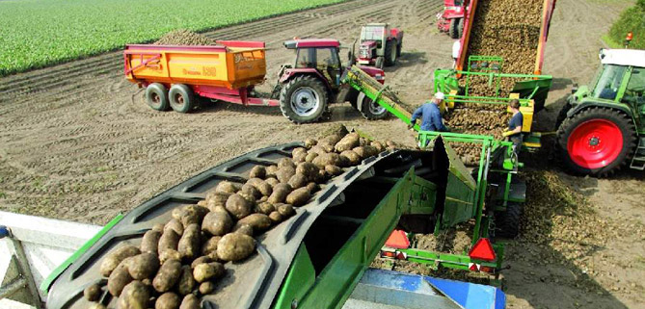
Islamic Agricultural Finance Products
Ijara – Islamic Lease
Ijarah Means Operating lease. It is an arrangement in which the Islamic Bank lease Agri. equipments, Tractor & light vehicles, Agri. Instruments, buildings or other facilities to a client, against an agreed rental.
Utilization :
Leasing of Tractors, Agri. Equipment, Threshers, Tub wells, small production unit lease, Sugarcane planter, Rice planter, harvesting vehicles etc.
Currently Practiced:
Al-Amal Microfinance Bank, NRDP, Wasil Foundation.
Amanah Islamic Bank – Philippines.

Slide 9
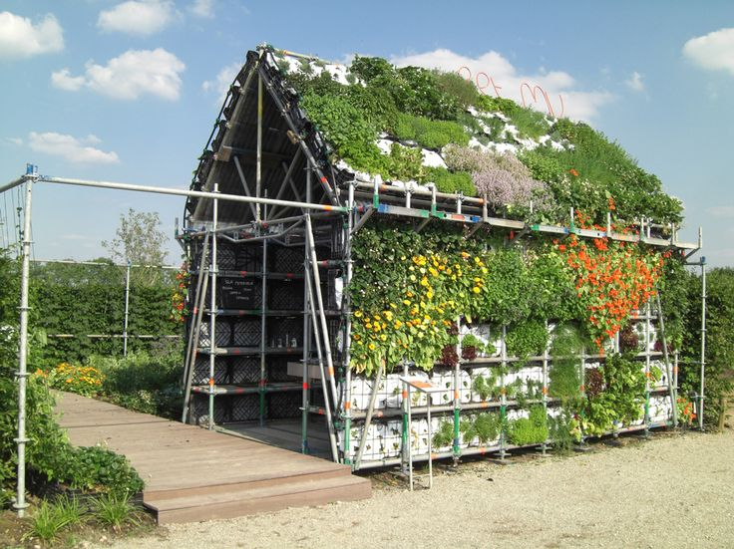
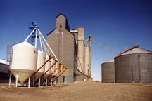

Islamic Agricultural Finance Products
Diminishing Musharkah
Diminishing Musharkah is a form of Musharakah where the Bank/MFI and the client participate in a joint commercial enterprise or property. This attains the form of undivided ownership of both, Over certain period the equity of financier is purchased by the client
Utilization:
It can be utilize for Rural housing, forest development, agri. Inputs, farming, sprinkler/drip/solar pumps, tube wells, Refrigeration vans etc.
Currently Practiced:
Islamic Bank Bangladesh, some Islamic banks etc.

Slide 10


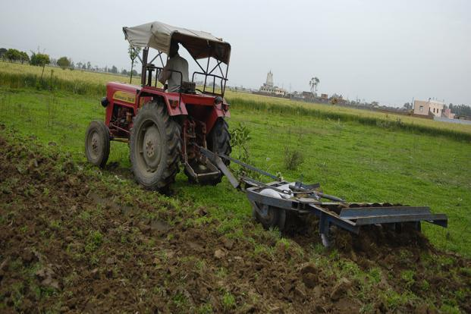
Islamic Agricultural Finance Products
Musharakah & Mudarabah- Partnership
Musharakah & Mudaraba means a relationship established under a contract by the mutual consent of the parties for sharing of profits and losses in the joint business.
Utilization :
Musharkah and Mudarabah can be used for Microenterprise & SME’S setup’s, Agricultural Joint venture projects, Dairy and livestock development etc.
Currently Practiced:
BOK, Amanah Islamic bank, AlBarakah MPCS etc

Slide 11
Islamic Agricultural Finance Products
Some other and Charitable Models of Islamic Agri. Finance
Muzahara ( Crop Sharing )
Musaqaa ( Irrigation Purposes )
Mugarsaa ( Orchid Financing )
Charitable Models :
Qarz e Hassan
Zakat Model
Waqf Model

Slide 12
Islamic Agri. And Rural Products
MicroTakaful
Salam, Istisna and other products
Non-Poor
Transitory Non-Poor
Transitory Vulnerable
Qarz-e-Hasan, Murabahah, Ijarah, Mudarabah
Transitory Poor
Chronic Poor
Zakat, Sadqa, Ushar
Extremely Poor
Notes:
In this slide we will learn that what islamic Microfinance Product will be ideal for what sector, We can categories poverty into Six level
12

Slide 13
Compatibility with other Rural Finance Models
Grameen Model: Amna Iftikhar – Malaysia, Islami Bank Bangladesh Limited etc.
Village Bank Model: Sanadiq program -Jabal al-Hoss, Syria, FINCA - Afghanistan etc.
Credit Union Model: Muslim Credit Union (Tobago), The Amwal Credit Union etc.
Cooperative Model: AlBaraka MPCS – Mauritius, Al- Khair Coop. – India, Muslim Community Coop.– Australia, Karakorum Cooperative Bank – Pakistan.
Self-Help Group: Aameen Society - India
For Profit Banks/MFIs Ghana Islamic Microfinance Banks – Ghana, Al – Amal Bank, Bank Islami - Pakistan

Slide 14
Size of Islamic Agri. & Rural Finance
Total Islamic Finance Industry size is 2.1 T. USD
More than 2,000 Islamic Financial Institutions are working in 100+ Countries.
Islamic Banking have 1.5 T. USD Share
Sukuk (Islamic Bond) have about 400 Billion USD.
While rest belong to Islamic Insurance, Islamic Funds, Islamic Leasing etc.
The Share of Islamic Micro and Rural Finance is Less than 1% within IF Industry.
Big Potential in African Countries

Slide 15
Islamic Micro/Rural finance Institution Worldwide
Germany:2
- Muslim Society
Switzerland: 2
UAE: 4
- Dubai Islamic Bank
- Abu Dhabi Islamic Bank
- HSBC Amanah
UK: 5
- HSBC Amanah
- Muslim Aid
- Islamic Relief
Faith Matters
- The Halal Mutual Investment Company
Kuwait: 2
- Kuwait Finance House
United States: 3
Helping Hands
ISNA
Lariba
Bahrain: 2
Family Bank
Afghanistan 9:
- FINCA , WOCCU
- CHF
Ariana
Iran: 8
Pakistan: 11
India: 3
Bangladesh:9
Turkey: 2
- Faisal Finance Institution
- Ikhlas Finance House
Egypt: 3
- Alwatany Bank of Egypt
- Egyptian Saudi Finance
Malaysia: 11
2 - Pure Islamic Banks (Bank Islam, Bank Muamalat)
Rest - banks
Sudan: 13
Yemen: 05
Al- Amal
Al Kuraimi
South Africa
Awqaf SA
IMFI’s Worldwide: 300 * in Countries: 32
Market Size: 1 billion USD
Indonesia: 133
BPRS , BMT.
Muaritius
AlBaraka MPCS

Slide 16
Some Islamic Microfinance Institutions - Worldwide
Countries | Islamic Microfinance Institutions
Indonesia | BPRS, Islamic Financial Cooperatives referred as bait Maal wat Tamwil (BMT)
Bangladesh | Islamic Bank Bangladesh, Social and Investment Bank, Al-Fallah and Rescue
Afghanistan | FINCA (Qard Hasan), WOCCU, Ariana Financial Services , IFIC, etc.
Pakistan | Akhuwat , Farz Foundation, ASASAH, Muslim Aid, Islamic Relief, CWCD, ,HHRD , NRSP, NRDP, Naymet etc.
Malaysia | Amina Iftikhar, Tabung Haji etc
India | AICMEU, BASIX, Sahulat, Bait-un-Nasr , Al-Khair Co-operative, Marwar Shariah Credit
Egypt | Mit Ghamar Project
Syria | Sanadiq project Jabal al Hoss
Lebanon | Mu’assat Bayat Al-Mal
Yeman | Hodeidah Microfinance Program, Al-Amal Microfinance Bank etc.
South Africa | Awqaf South Africa
U.K | Faith Matters, Islamic Relief, Muslim Aid, HSBC Amanah etc.
Tanzania | Hajj Trust, Four SACCOS

Slide 17
Factors to be considered while doing Islamic Agri. & Rural
Poverty Alleviation Element
and more….
Moral
Ethical
Social
A Misconception removed
Islamic Finance is a system not the Religion, it can be utilized & operated by both Muslims and
Non-Muslim Communities for Poverty Alleviation, Social & Economic Development.
Micro Takaful
Islamic
Micro
Finance
Free from Gharar
Free from Interest
Financing
Shariah Compliant Funds
Ensure Shariah Compliance
Trainings & Quality HR
Shariah Vetted Products
Shariah Compliant Investments

Slide 18
Challenges for the Development of Islamic Agri. & Rural Finance
Non - Availability of Donor/Shariah Compliant Sources of Funds
Need to develop a uniform regulatory and legal framework for the Islamic Agricultural Finance.
Accounting & I.T systems., Rating Agencies.
Lack of Quality HR in Islamic Agri./Rural Finance Sector.
Standardization of Products.
Reluctance in Research & Implementation of new Products, as only (Murabahah) is serving almost 80% of Islamic Agri./Microfinance Industry.
Introduce new product line on the basis of Musaqa, Muzara’a & Mugharasa
Development of Shairah Expertise towards the Growth of Islamic Agricultural Finance.

Slide 19
Opportunities
IDB - Microfinance Development Program (MDP )
I.T Integration of Islamic Rural & Agri. Finance Products
Supportive role of Government.
Expansion of Market where the Conventional Agri. Finance Products face limitations especially in Muslim Majority Countries
AlHuda Centre of Excellence in Islamic Microfinance is offering Services for the development of Islamic Agri. Finance Products
Islamic Banking and Finance is emerging in South Asia, Central Asia & MENA region which will strengthened the Islamic Agri. Finance products effectively.

Slide 20
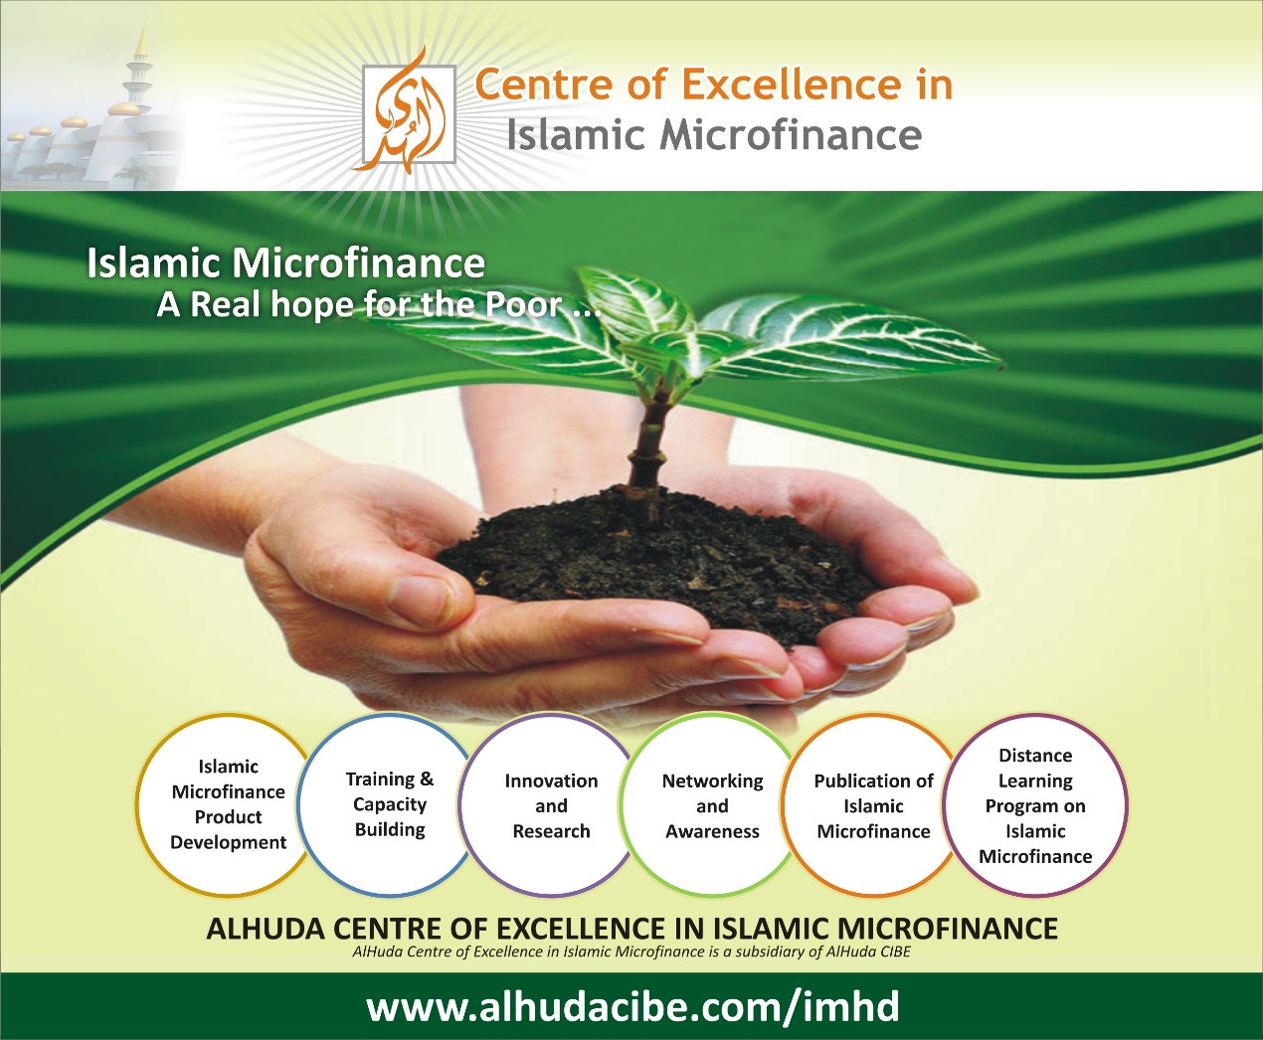

Slide 21
JazzakAllah Thank you for listening with patience
Muhammad Zubair Mughal
Chief Executive Officer
AlHuda Centre of Islamic Banking and Economics
Zubair.mughal@alhudacibe.com
www.alhudacibe.com

