Slide 1

FinTech in Microfinance and Agriculture Finance
By: Muhammad Zubair Mughal
Chief Executive Officer- CEO
AlHuda Center of Islamic Banking & Economics

Slide 2
What is FinTech?
Currently there is not a universally accepted definition of the term “FinTech”
FinTech is to combine financial services with modern and innovative technologies
It is clearly a rapidly growing industry as investments in these technologies are growingly exponentially
The fintech revolution started post 2007-2008 financial crisis
FinTech services are for peer-to-peer (P2P) lending, crowdfunding, money transfer, mobile payments and trading platforms

Slide 3
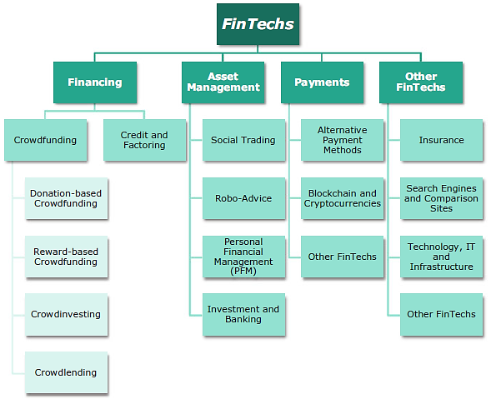
Segments of FinTech Industry

Slide 4
FinTech Features
Convenience
Provide the means to keep economies expanding while traditional methods and limited applicability
Improved, efficient and Secured Payment System
Speed with accuracy
Innovative way to address the Financial data mining issues, Activity Reports, etc.
User Friendly
Efficient Time Management

Slide 5
FinTech Challenges
Unavailability of Regulatory Framework
Not Suitable with existing Financial Systems
Rapid developments in technology cause financial Institutions to invest more on technology in competitive markets
Rapidly changes make regulations a problem and provide outlet for criminal activities

Slide 6
Islamic FinTech
A few prominent FinTech companies that offer Shariah-compliant financial solutions are Dubai-based Beehive, Jakarta-based Blossom Finance, and Singapore-based KapitalBoost and ClubEthis deals in P2P lending and CrowdFunding
FinTech in the Islamic finance positively contributes to the evolution of the Islamic finance products and services
Elimination of credit intermediaries results in lower prices
Crowdfunding and P2P financing provides the platform for Musharakah- and Mudharabah-based equity financing which are not in traditional IFI environment

Slide 7
Islamic FinTech Initiatives
Investment Account Platform (IAP) first Malaysian Multi-Banks financial intermediation in Feb-2016 by Six Islamic Banks
Islamic FinTech Alliance (IFT) by Eight global crowdfunding platform in April-2016 in Malaysia
World’s first automated Islamic investment platform with “the aim of providing access to halal portfolio management for 2 billion Muslims in Sep-2016
Asia’s first Shariah compliant Robo Advisor: Algebra brings together the sound investment principles of Shariah compliant funds with the next generation investment tools in Malaysia on Oct-2016
Future Finance 2030, the first Global Islamic Fintech Hub which would be the focal point of the fast growing Islamic FinTech

Slide 8
FinTech in Microfinance
FinTech has impact on conventional finance and microfinance alike
According to World Bank, FinTech is helpful for Financial Inclusion
MFIs should set up their own e-money system by creating a cash-in/cash-out agent network, loan decision-making, and other essential banking functions
Tremendous growth of internet access and smartphones fuled-up FinTech
FinTech helps to bank the unbanked population

Slide 9
FinTech in Islamic Microfinance
By the World Bank, FinTech in Islamic Finance is in its early stages of development although has various initiatives
Some FinTech based Islamic microfinance
- Malaysia based Ethis-Kapital
- Singapore based Kapital Boost
- Indonesia based Trust Network Finance- TNF

Slide 10
FinTech in Agricultural Finance
Village Capital has announced the first winners of its innovative program, East Africa: FinTech for Agriculture 2015- program is supported by the DOEN Foundation, The MasterCard Foundation and Duncan Goldie-Scot
Issues of FinTech in Agricultural Finance:
— Lack of physical access points
— lack of formal banking institutions who understand the needs of the agricultural community
— Lack of timely availability of funds for farmers
— Lack of Credit information of Farmar and CIB.

Slide 11
FinTech in Islamic Agricultural finance
According to Ericsson Mobility Report by 2020, 70% population would be using smartphones: So great potential exist for Islamic microfinance FinTech
Untapped market should be addressed through Shariah Compliant FinTech
To provide access points by mobile payments, retail store points, etc. in remote areas
According to EY the adoption of FinTech is not an option anymore So
As FinTech helps for better risk management: Islamic microfinance product will be free from Shariah risk and efficiency

Slide 12
Conclusion
To provide Financial services through technology
Shariah Compliant FinTech Initiatives are demanding in Muslim Countries and non-Muslim countries as well
It is newly introduced, rapidly growing sector
Need Comprehensive and suitable regulation framework
FinTech in Islamic Microfinance and Islamic Agricultural Finance has huge potential to grow
More initiatives are required to set up FinTech institutions
Enhance Financial Inclusion among poor and unbanked population

Slide 13


Slide 14


